Slide 2


Augustine Correa
Microsoft MVP
@augvcor

Slide 3
Securing a Blazor WASM app deployed on Azure Static Web Apps
From local development to cloud deployment

Slide 4





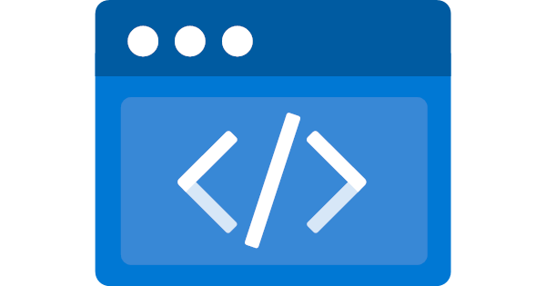








A few words
Notes:
Logos to be precise
LAMP, MEAN, modern UI experiences
Tight coupling, monolith
Prerendering, decoupling
Similar equivalent -> serverless, microservices

Slide 5

Local Development
Static Web Apps CLI
npm install -g @azure/static-web-apps-cli
Notes:
In yore.
Circuitous, especially for crosscutting concern and infrastructure dependent
Approximation of Azure SWA

Slide 6
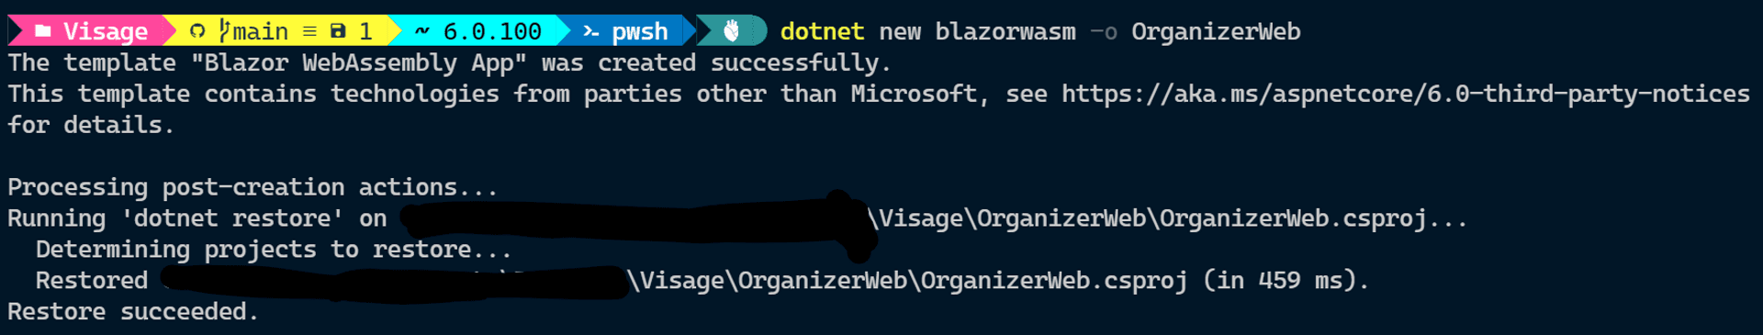
In the beginning…
Notes:
. Ensure main branch
. One year anniversary

Slide 7
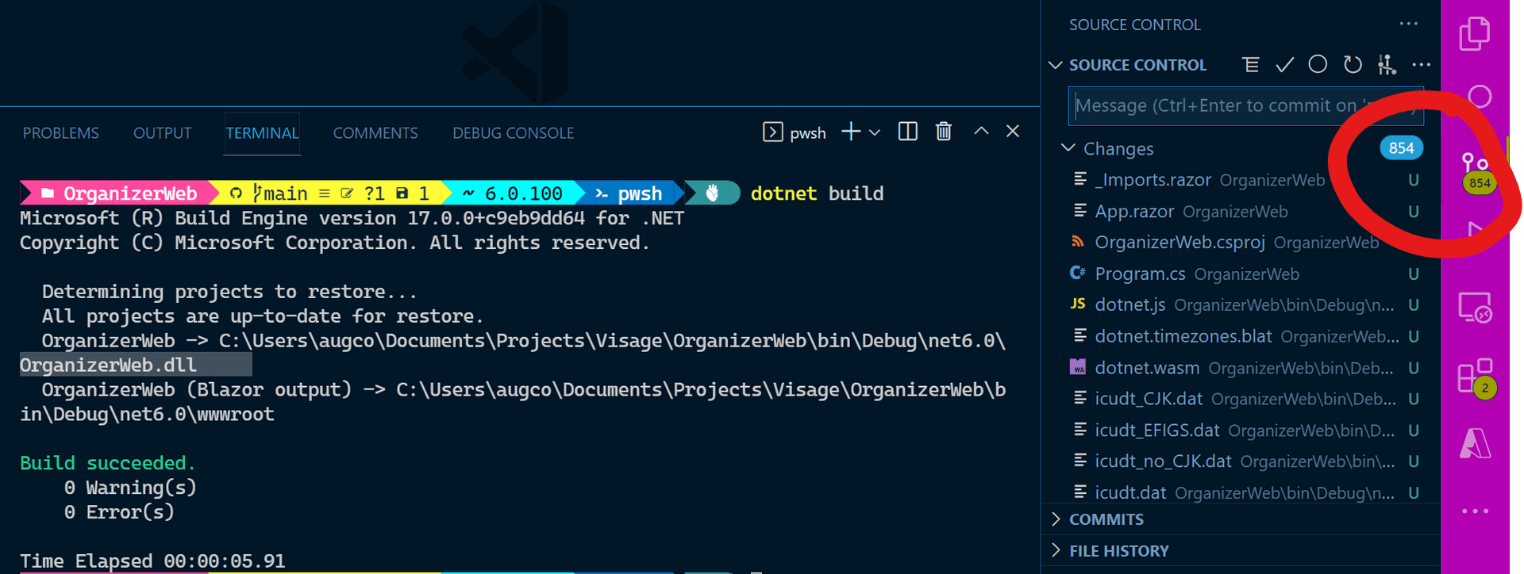
Bane of modern SW

Slide 8
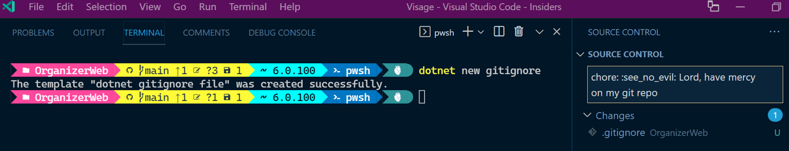
Don’t burden the repo

Slide 9
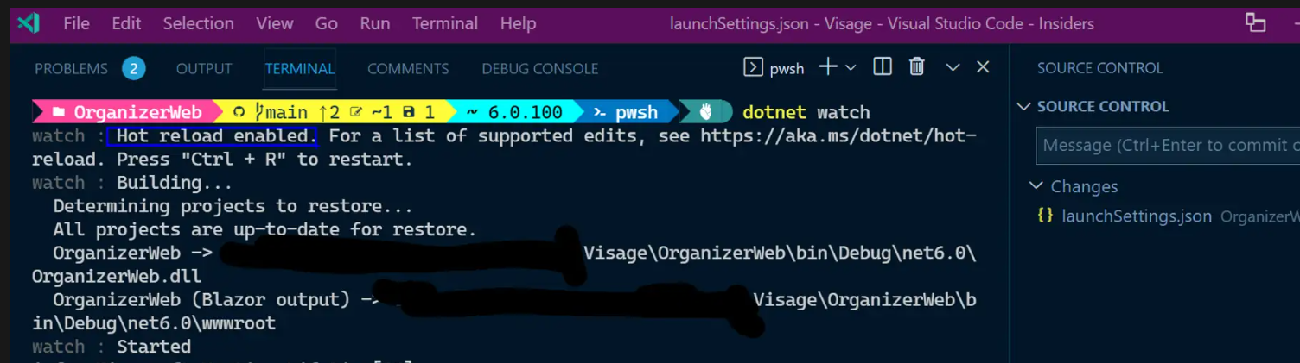
Fire🔥

Slide 10
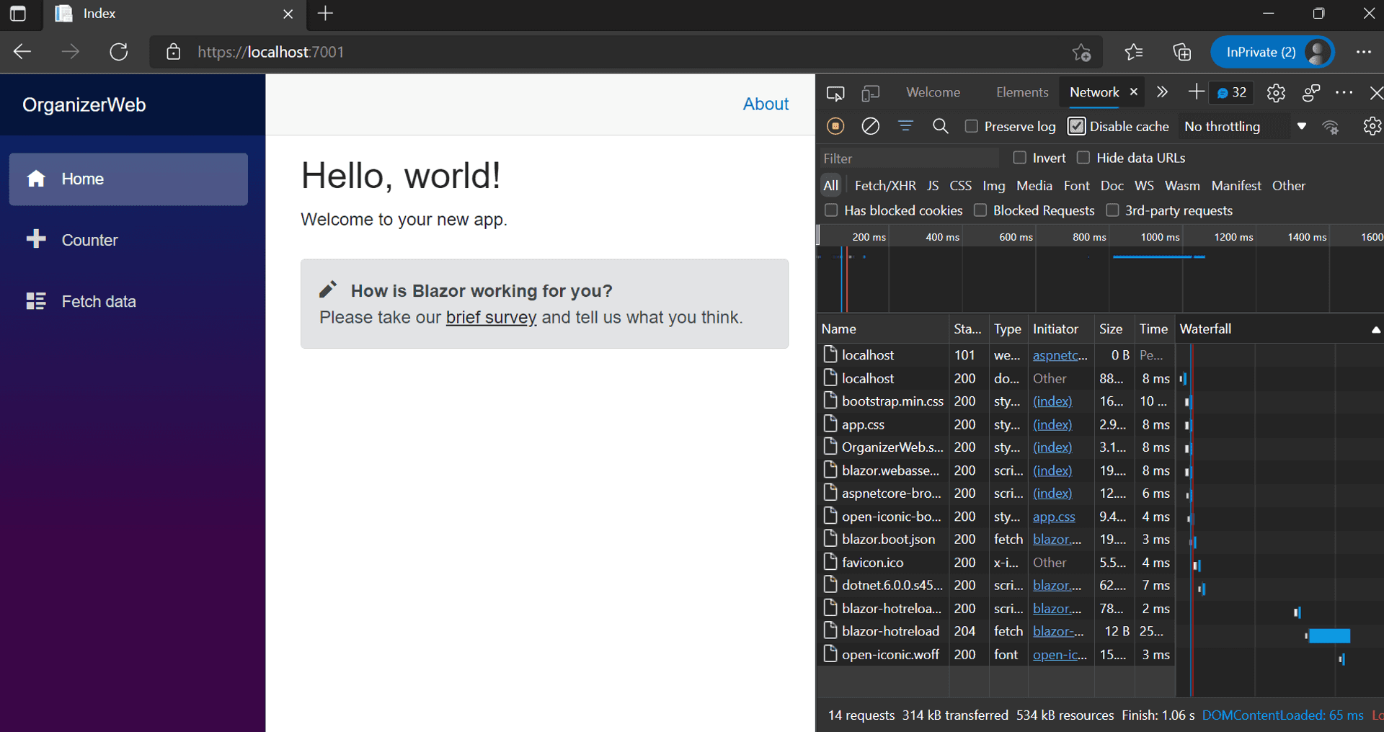
Looks good

Slide 11
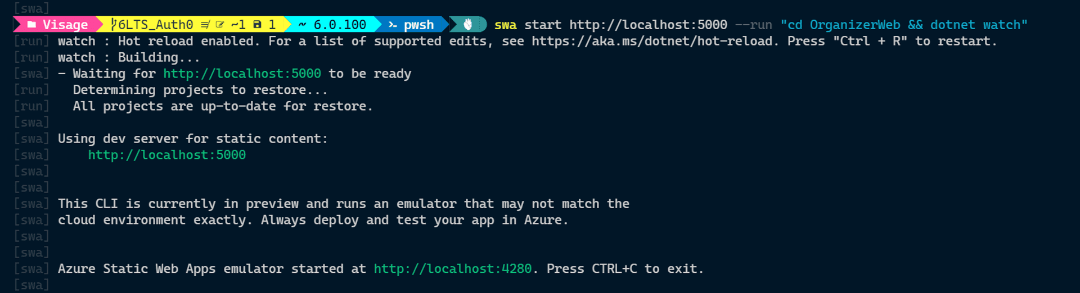
🚀

Slide 12
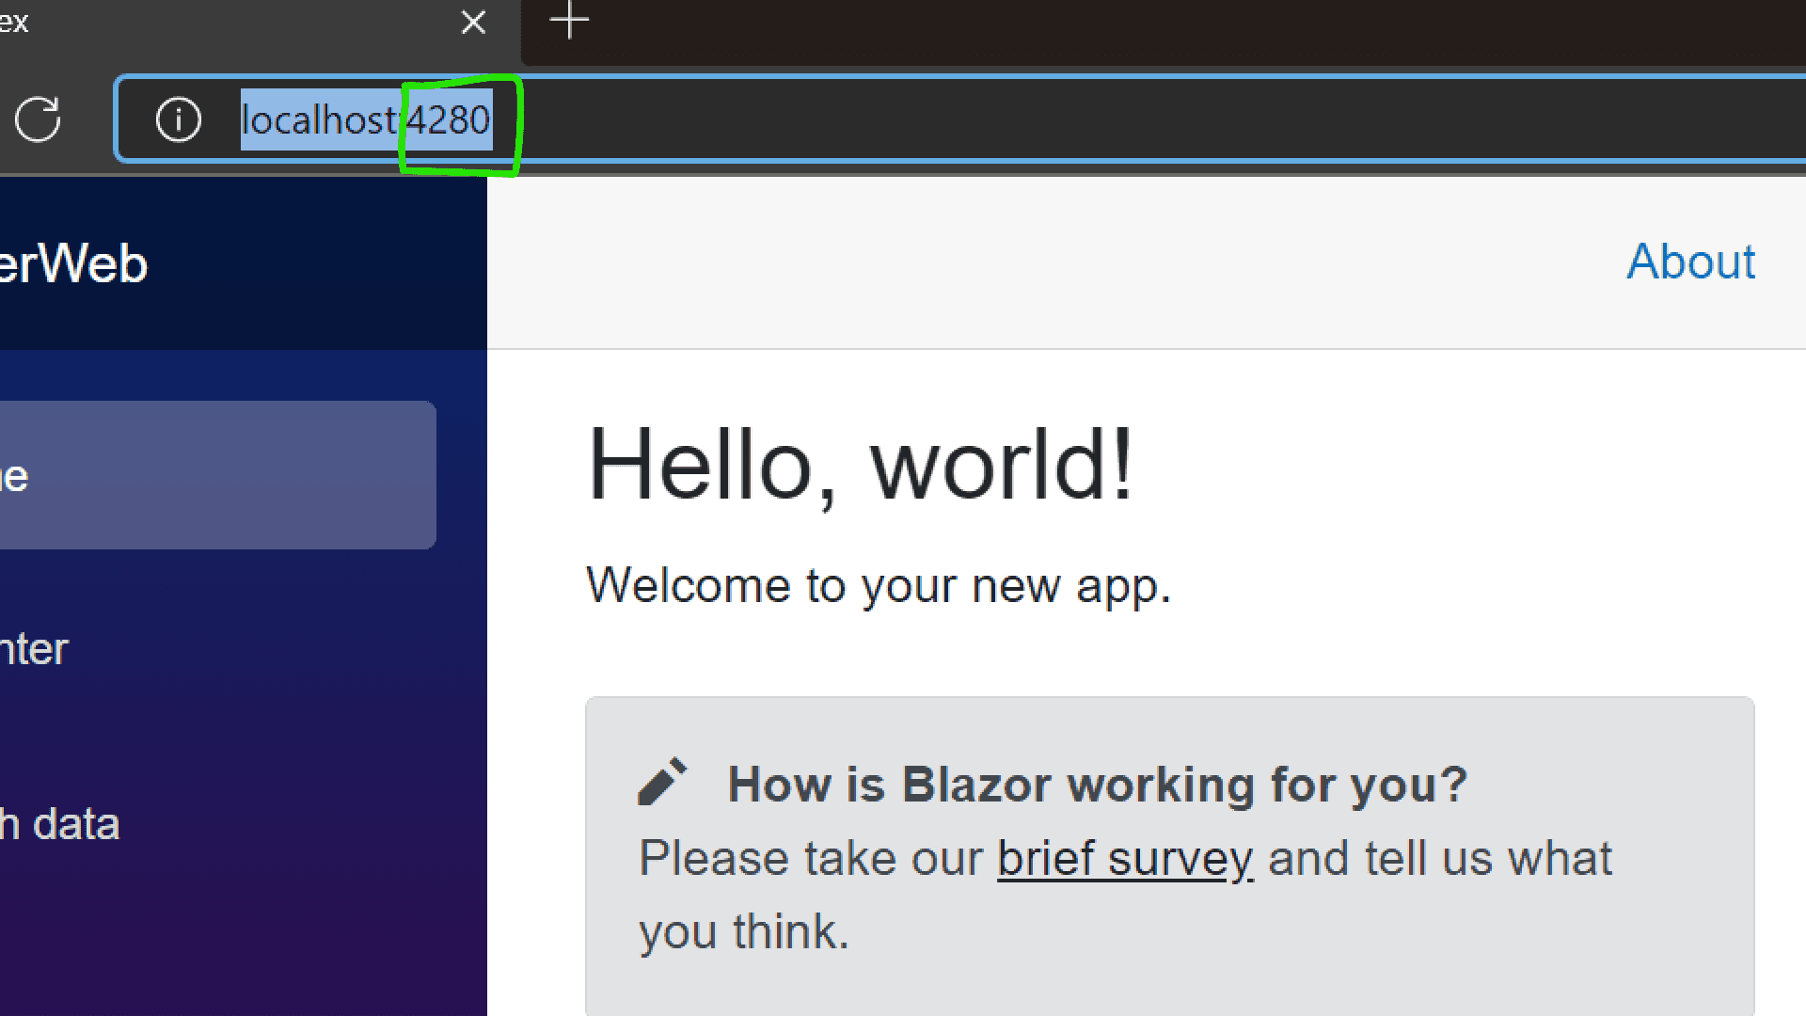
A tale of two browsers

Slide 13
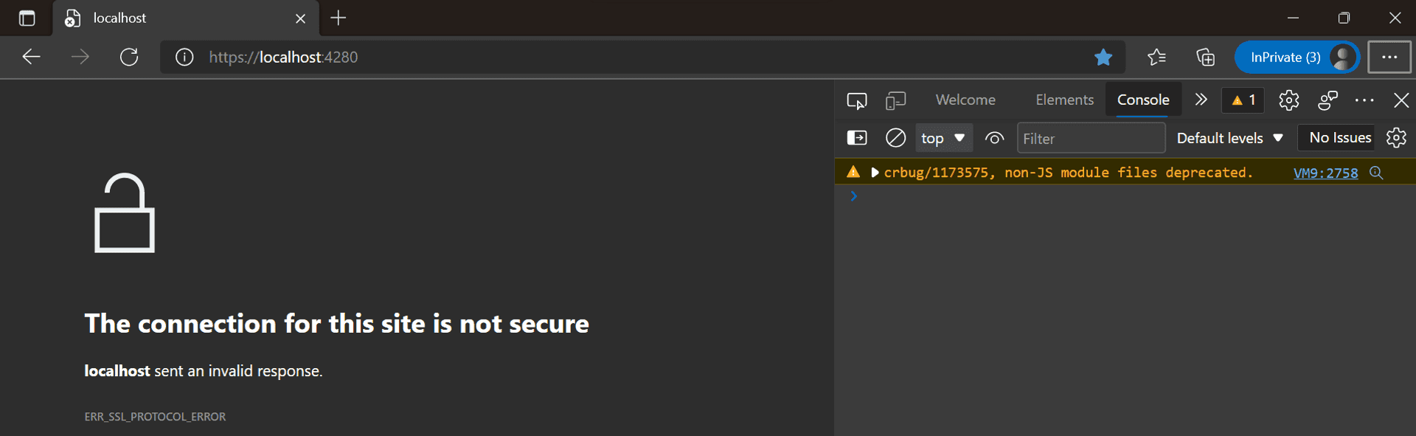
SSL

Slide 14
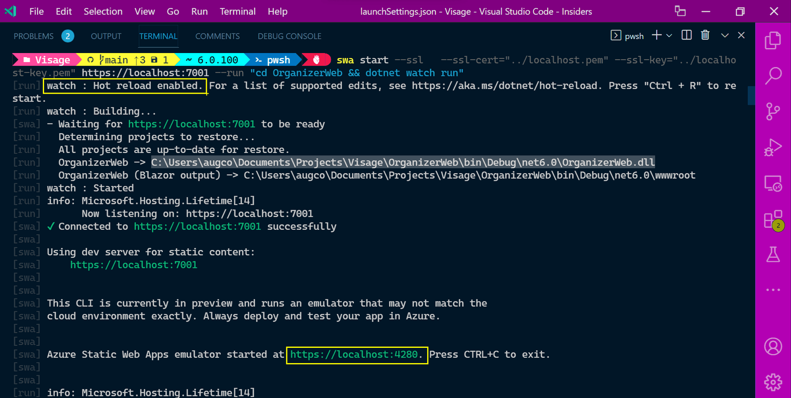

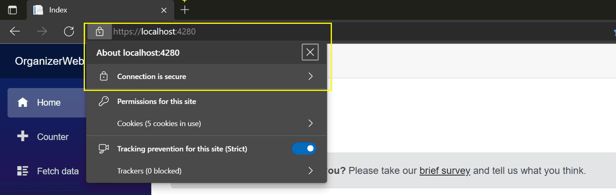
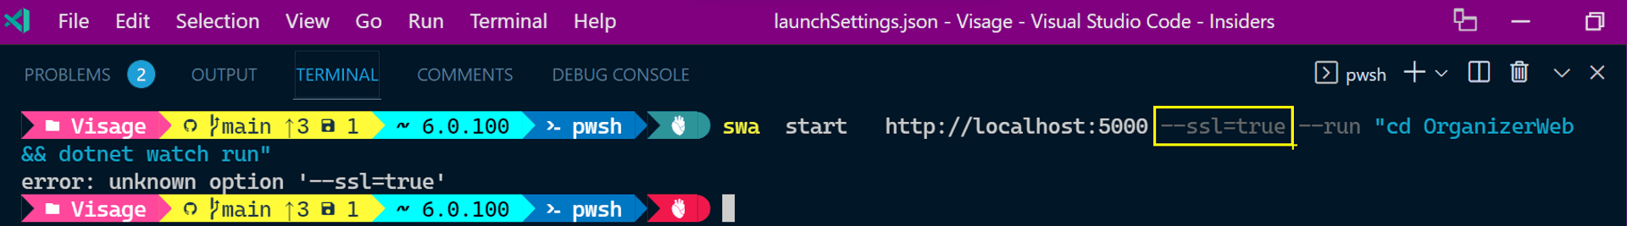
SSL Options

Slide 15
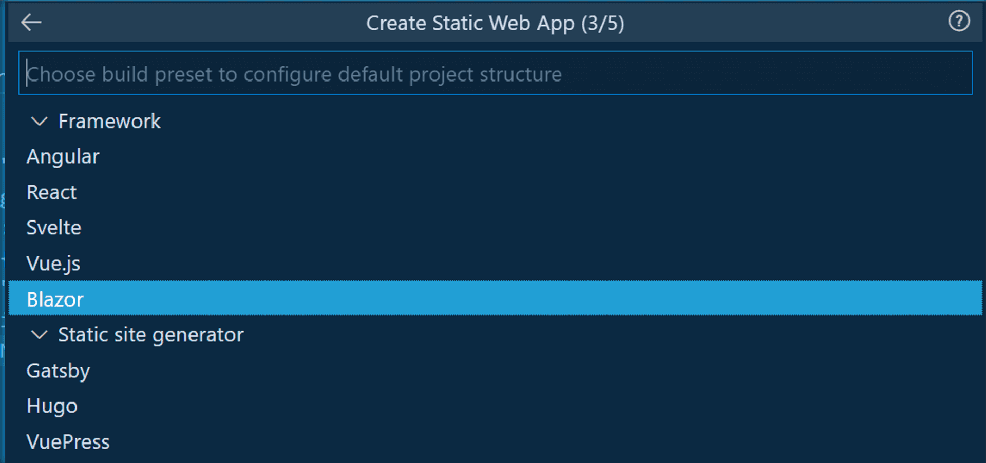
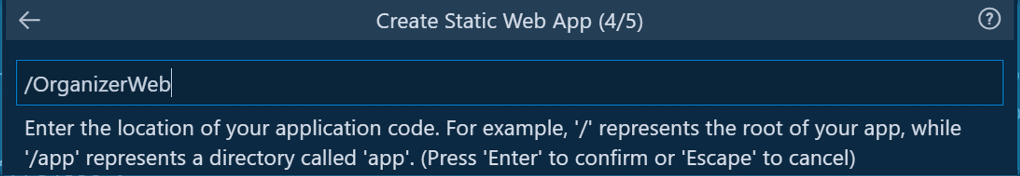
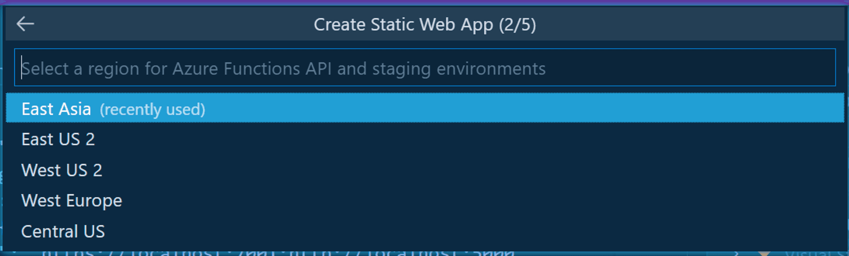
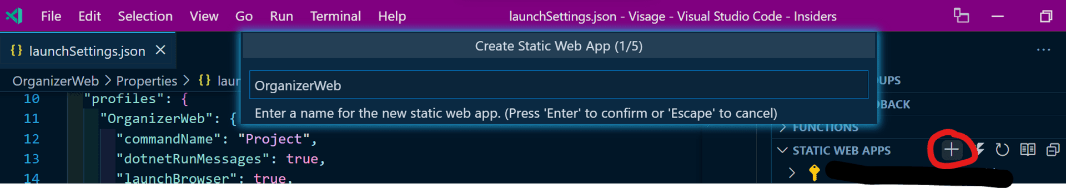
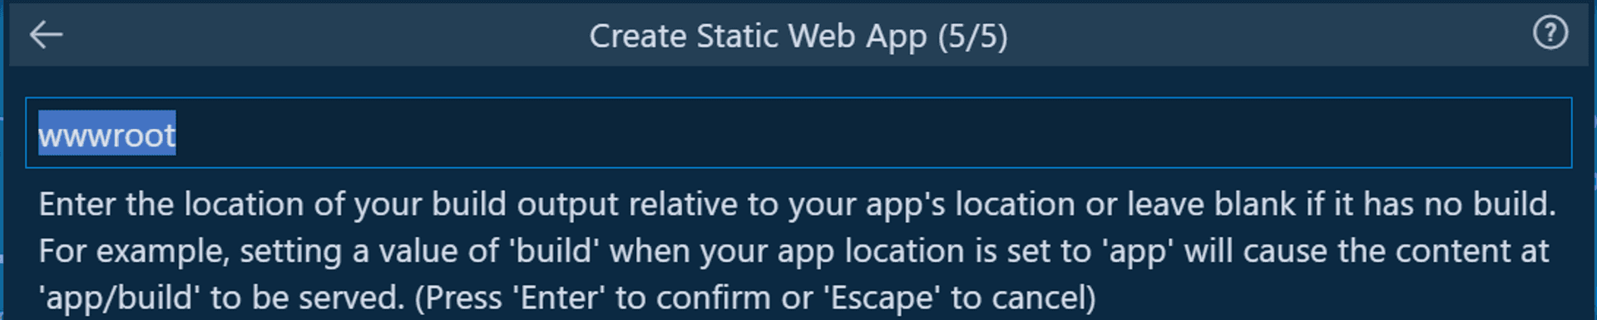
☁️
Azure SWA VS Code Extension

Slide 16
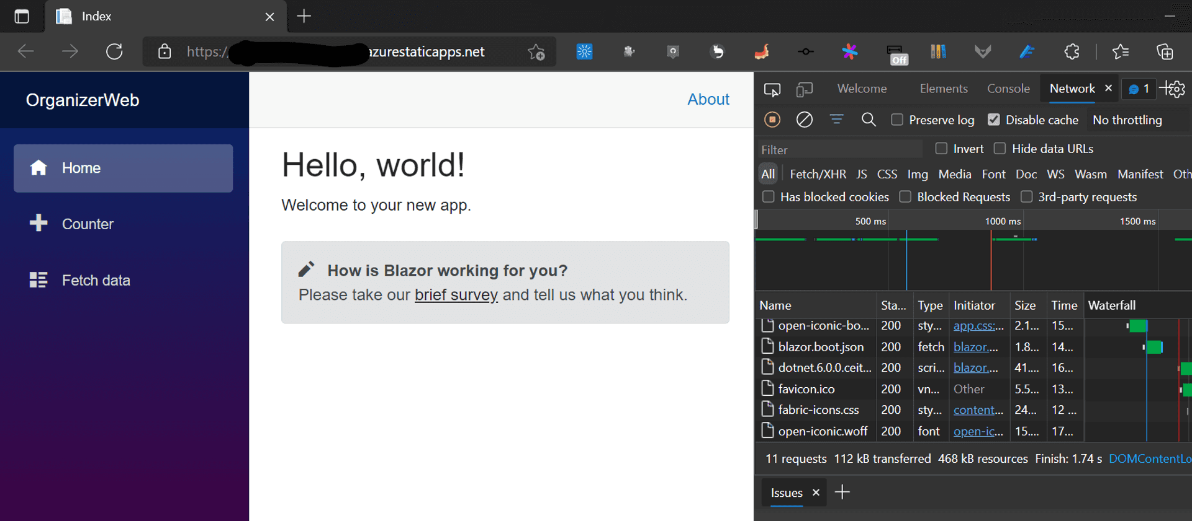
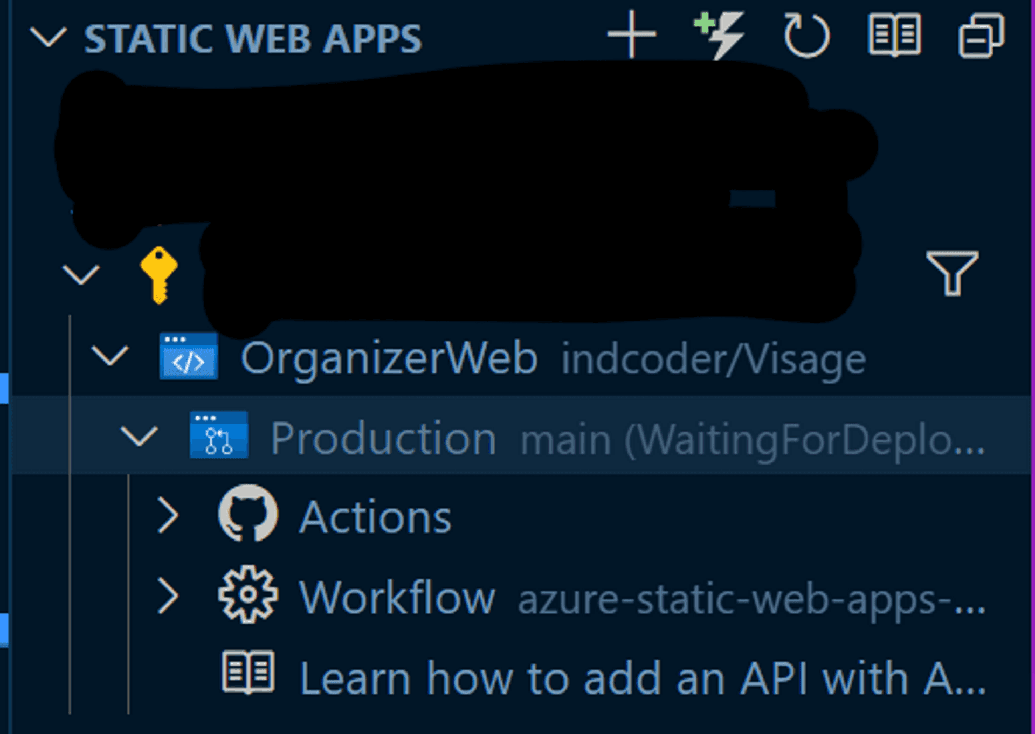
Deploy from VS Code

Slide 17
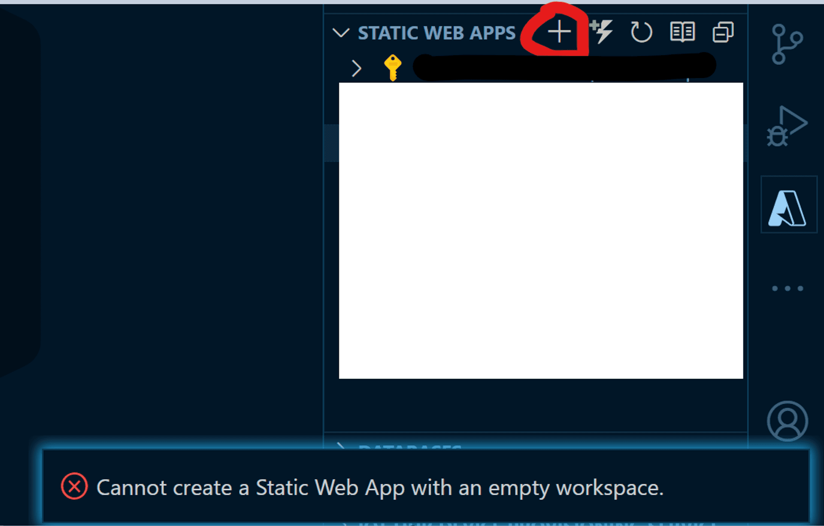
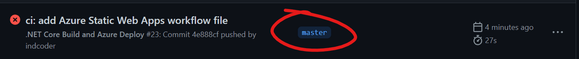
Things that tripped me
1. No Empty folder
2. Tinkering with gitignore??
3. Main branch

Slide 18


Authentication

Slide 19
Pre configured Providers
1. GitHub
2. Twitter
3. Azure AD
😀

Slide 20
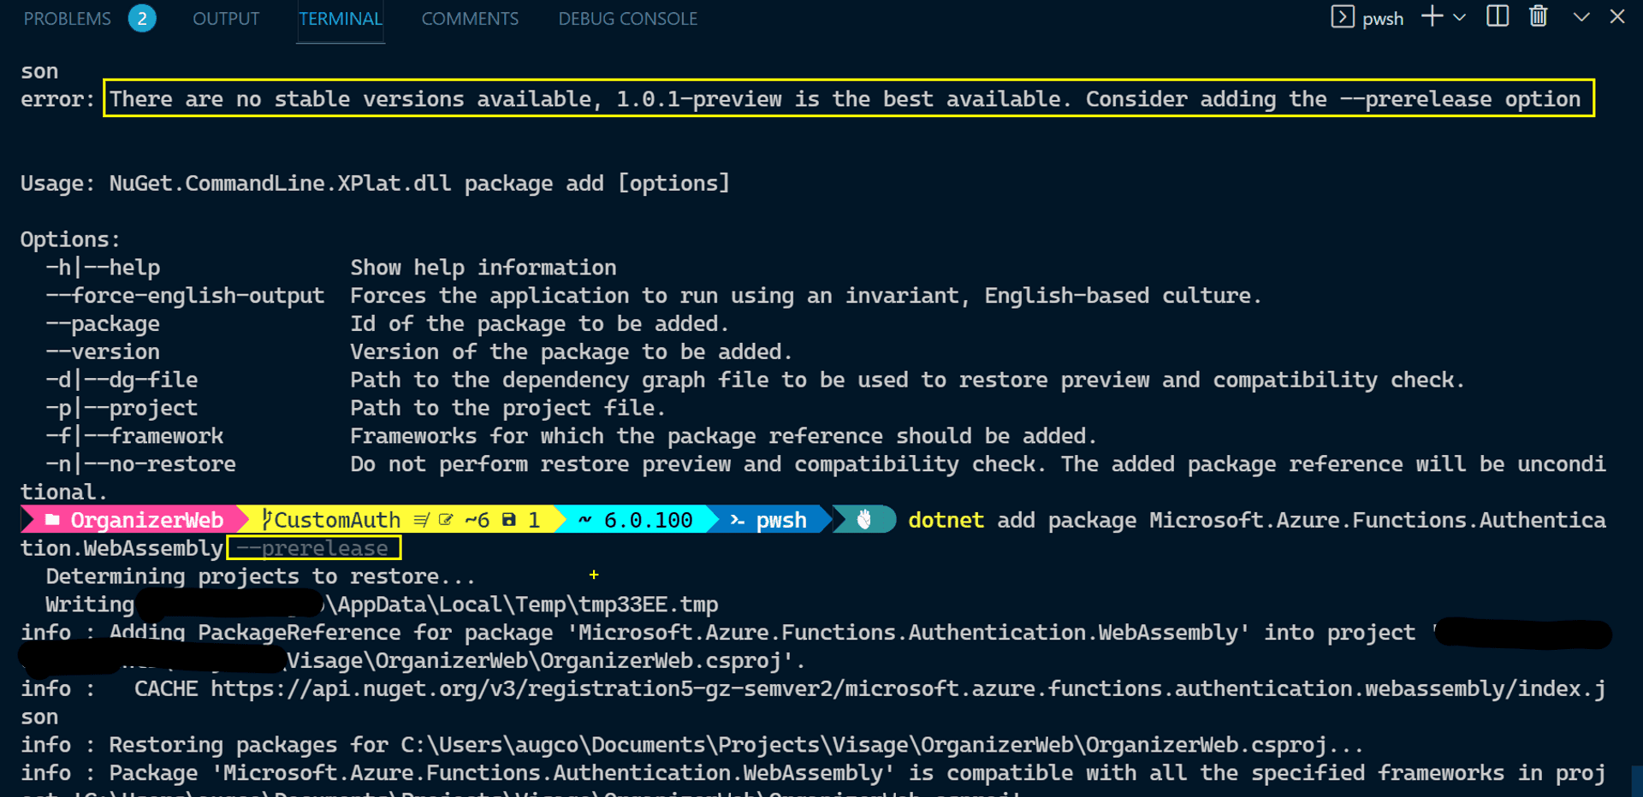
Ooh a shiny .Net library

Slide 21
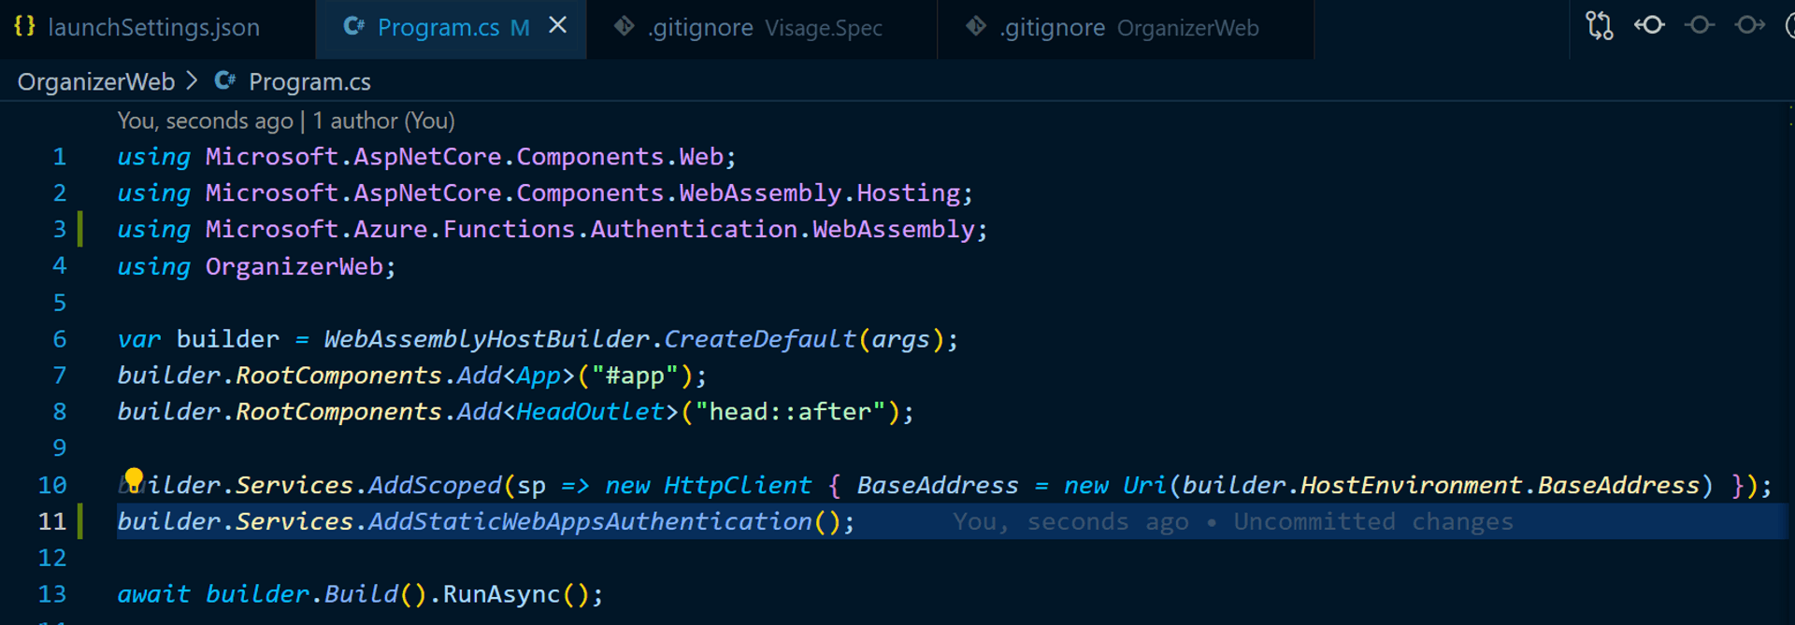
Register the service

Slide 22
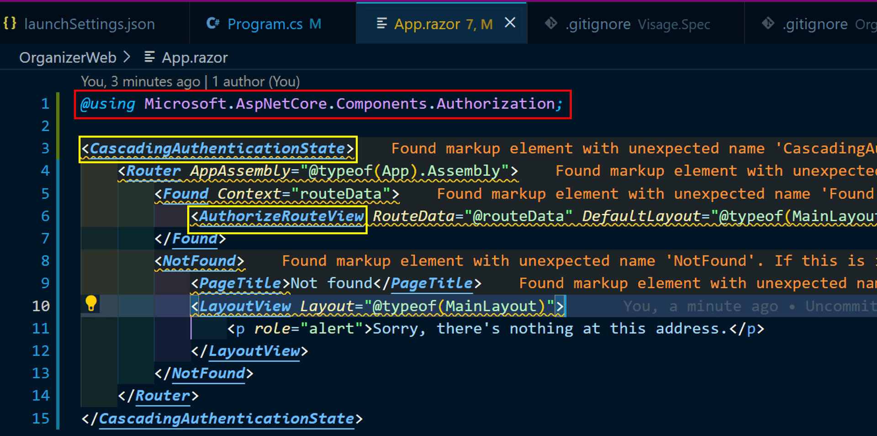
Scaffolding

Slide 23
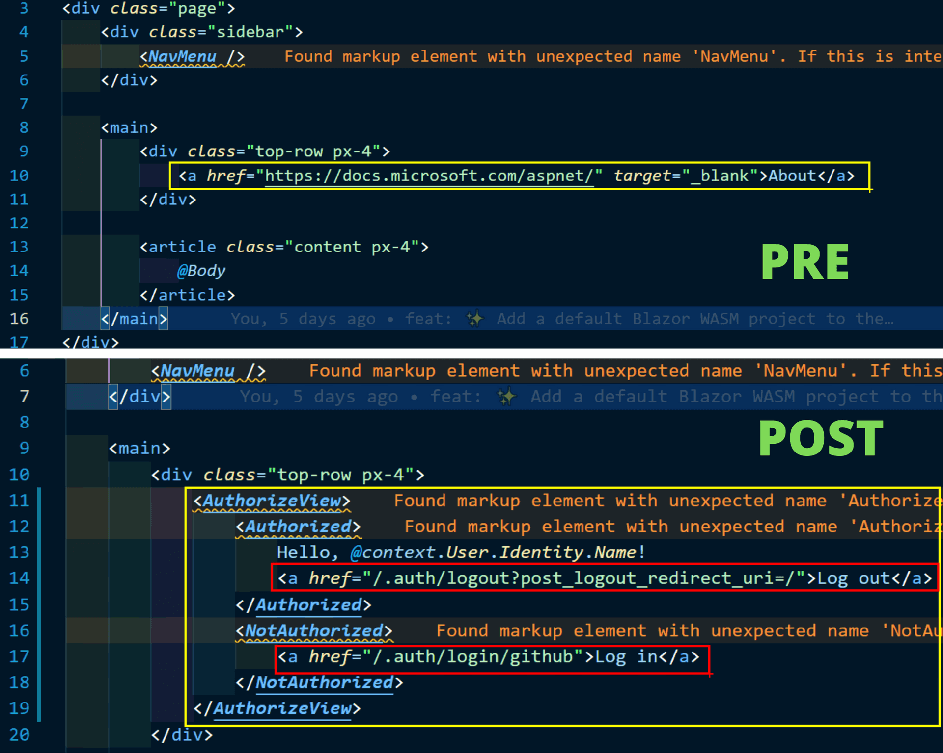
What about Login?

Slide 24
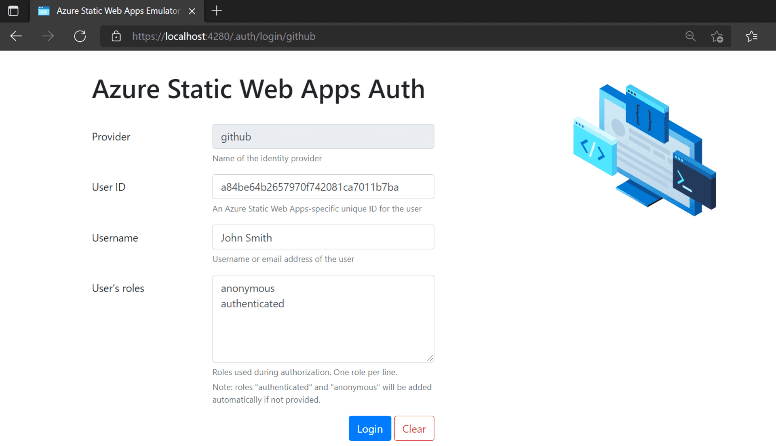
Locala?

Slide 25
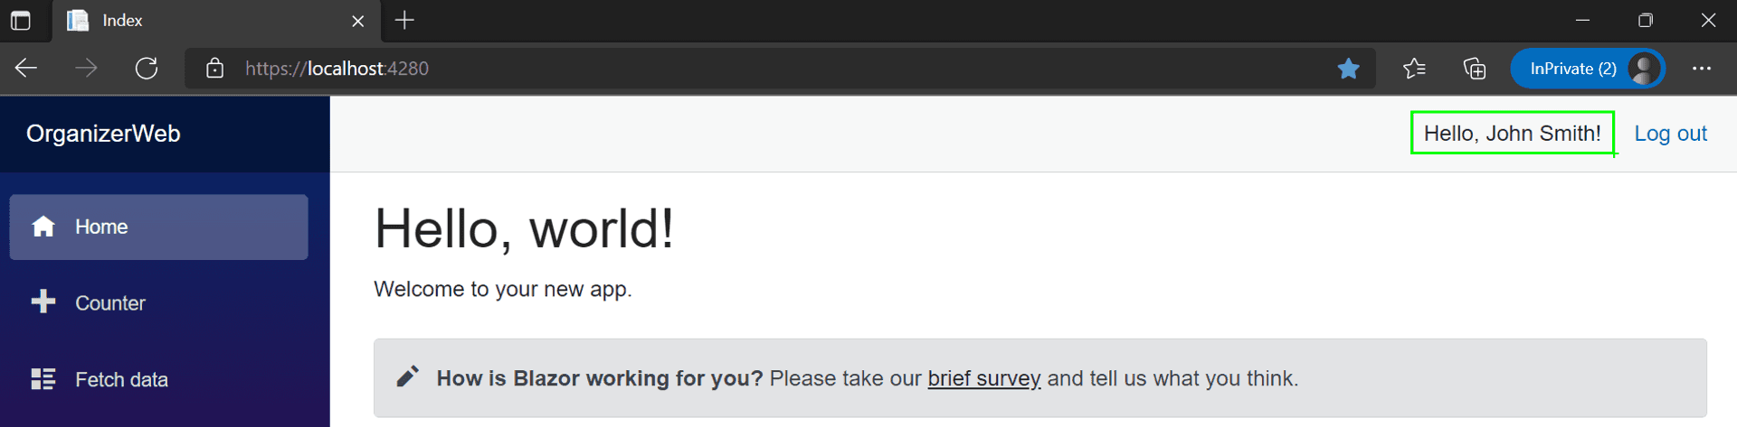
Voila

Slide 26
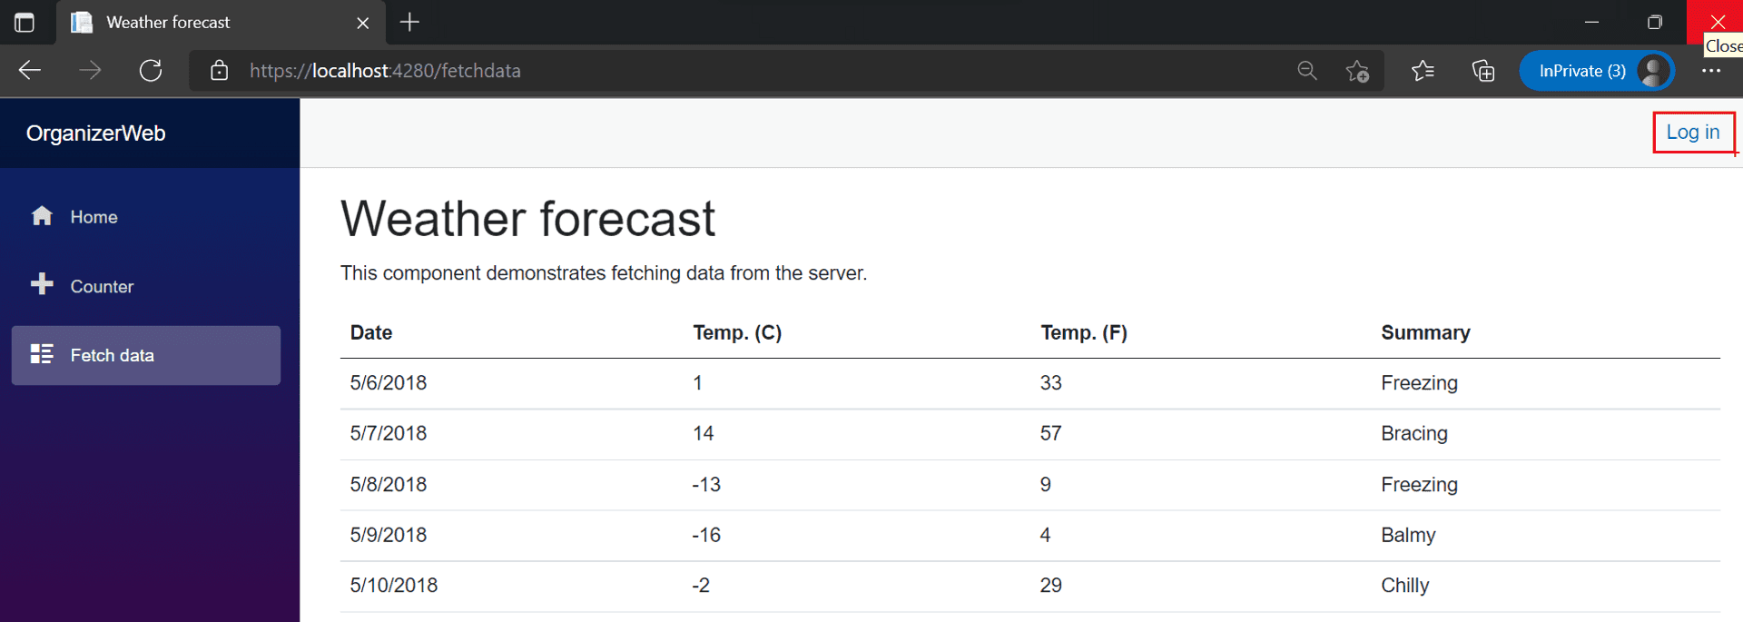
Free for all?

Slide 27
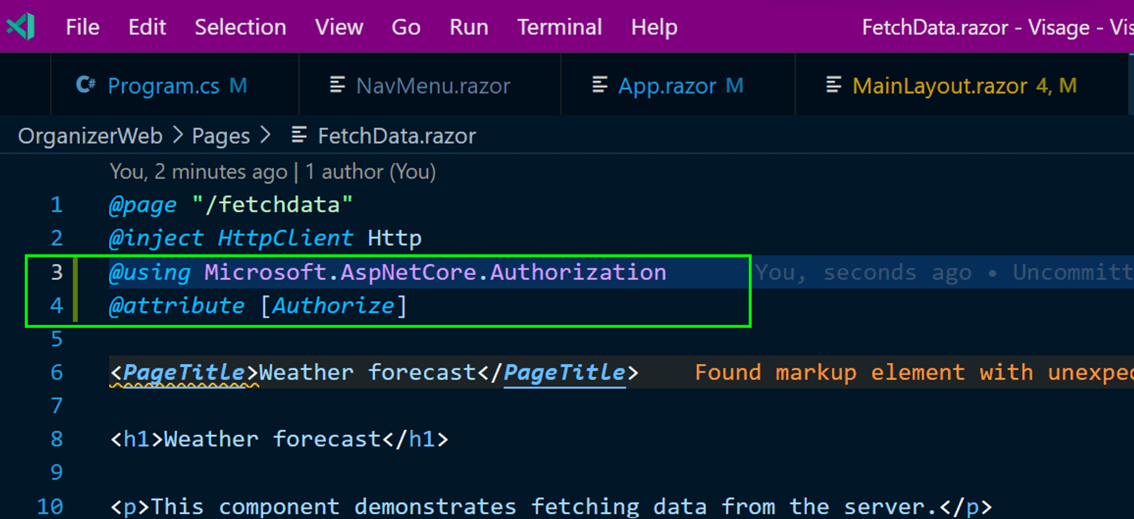
U can’t touch this

Slide 28
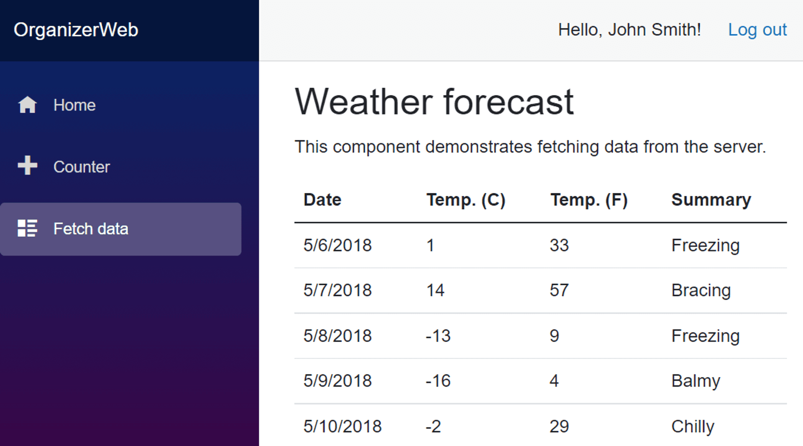
Anyone can?

Slide 29
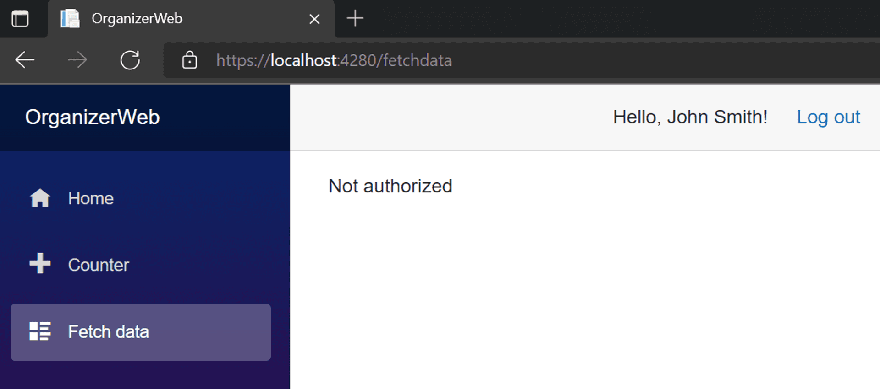
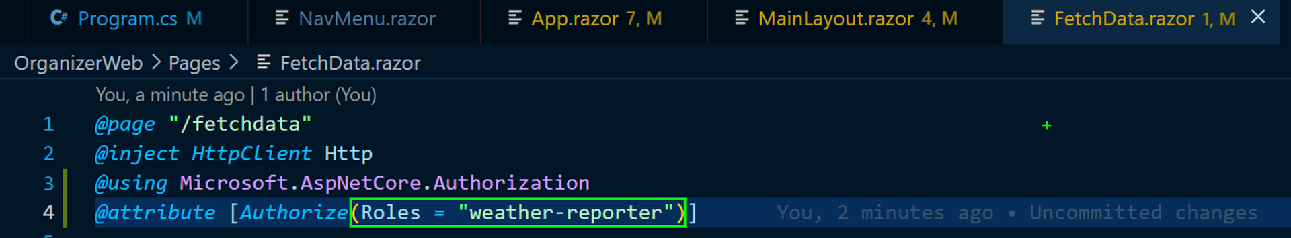
RBAC

Slide 30
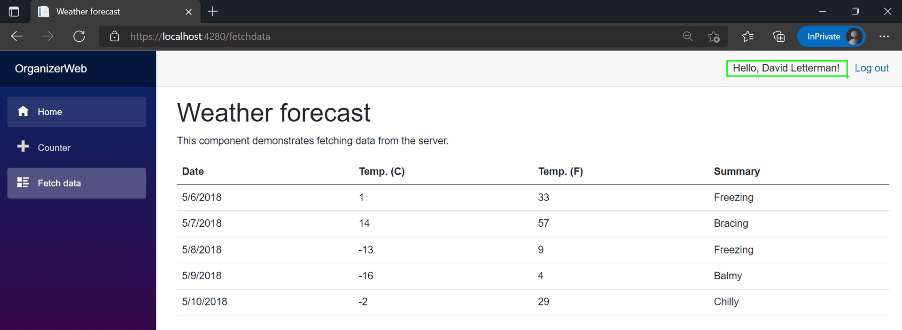
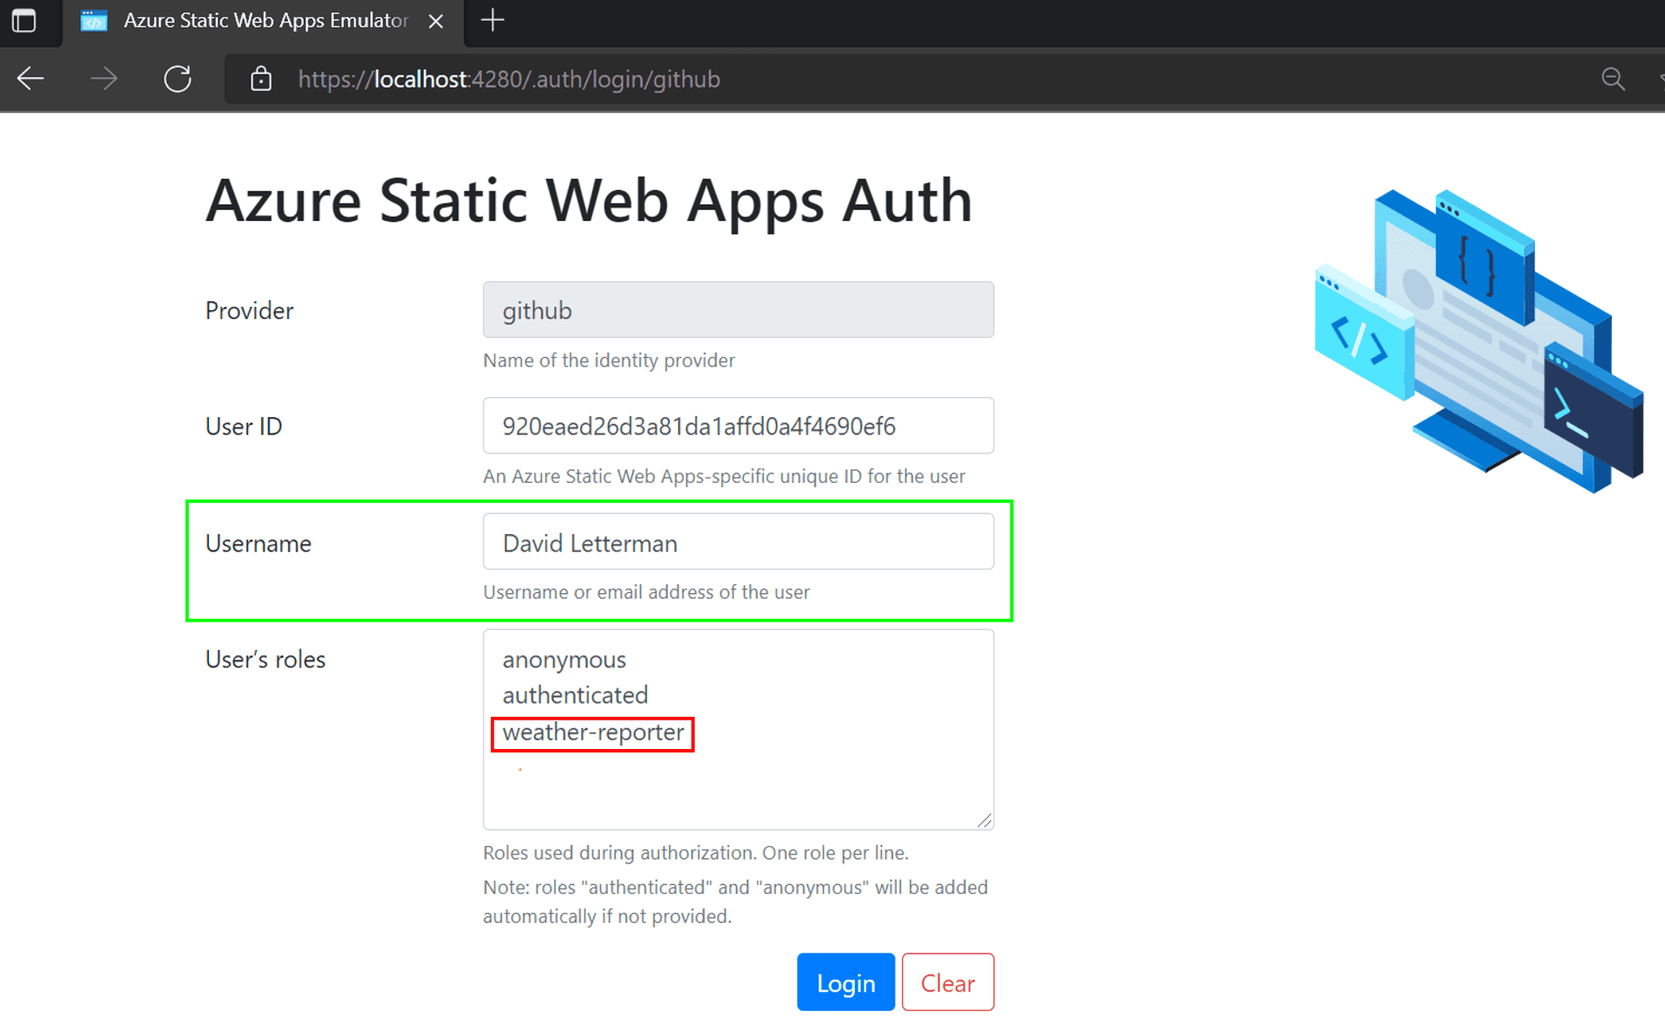

David Letterman

Slide 31
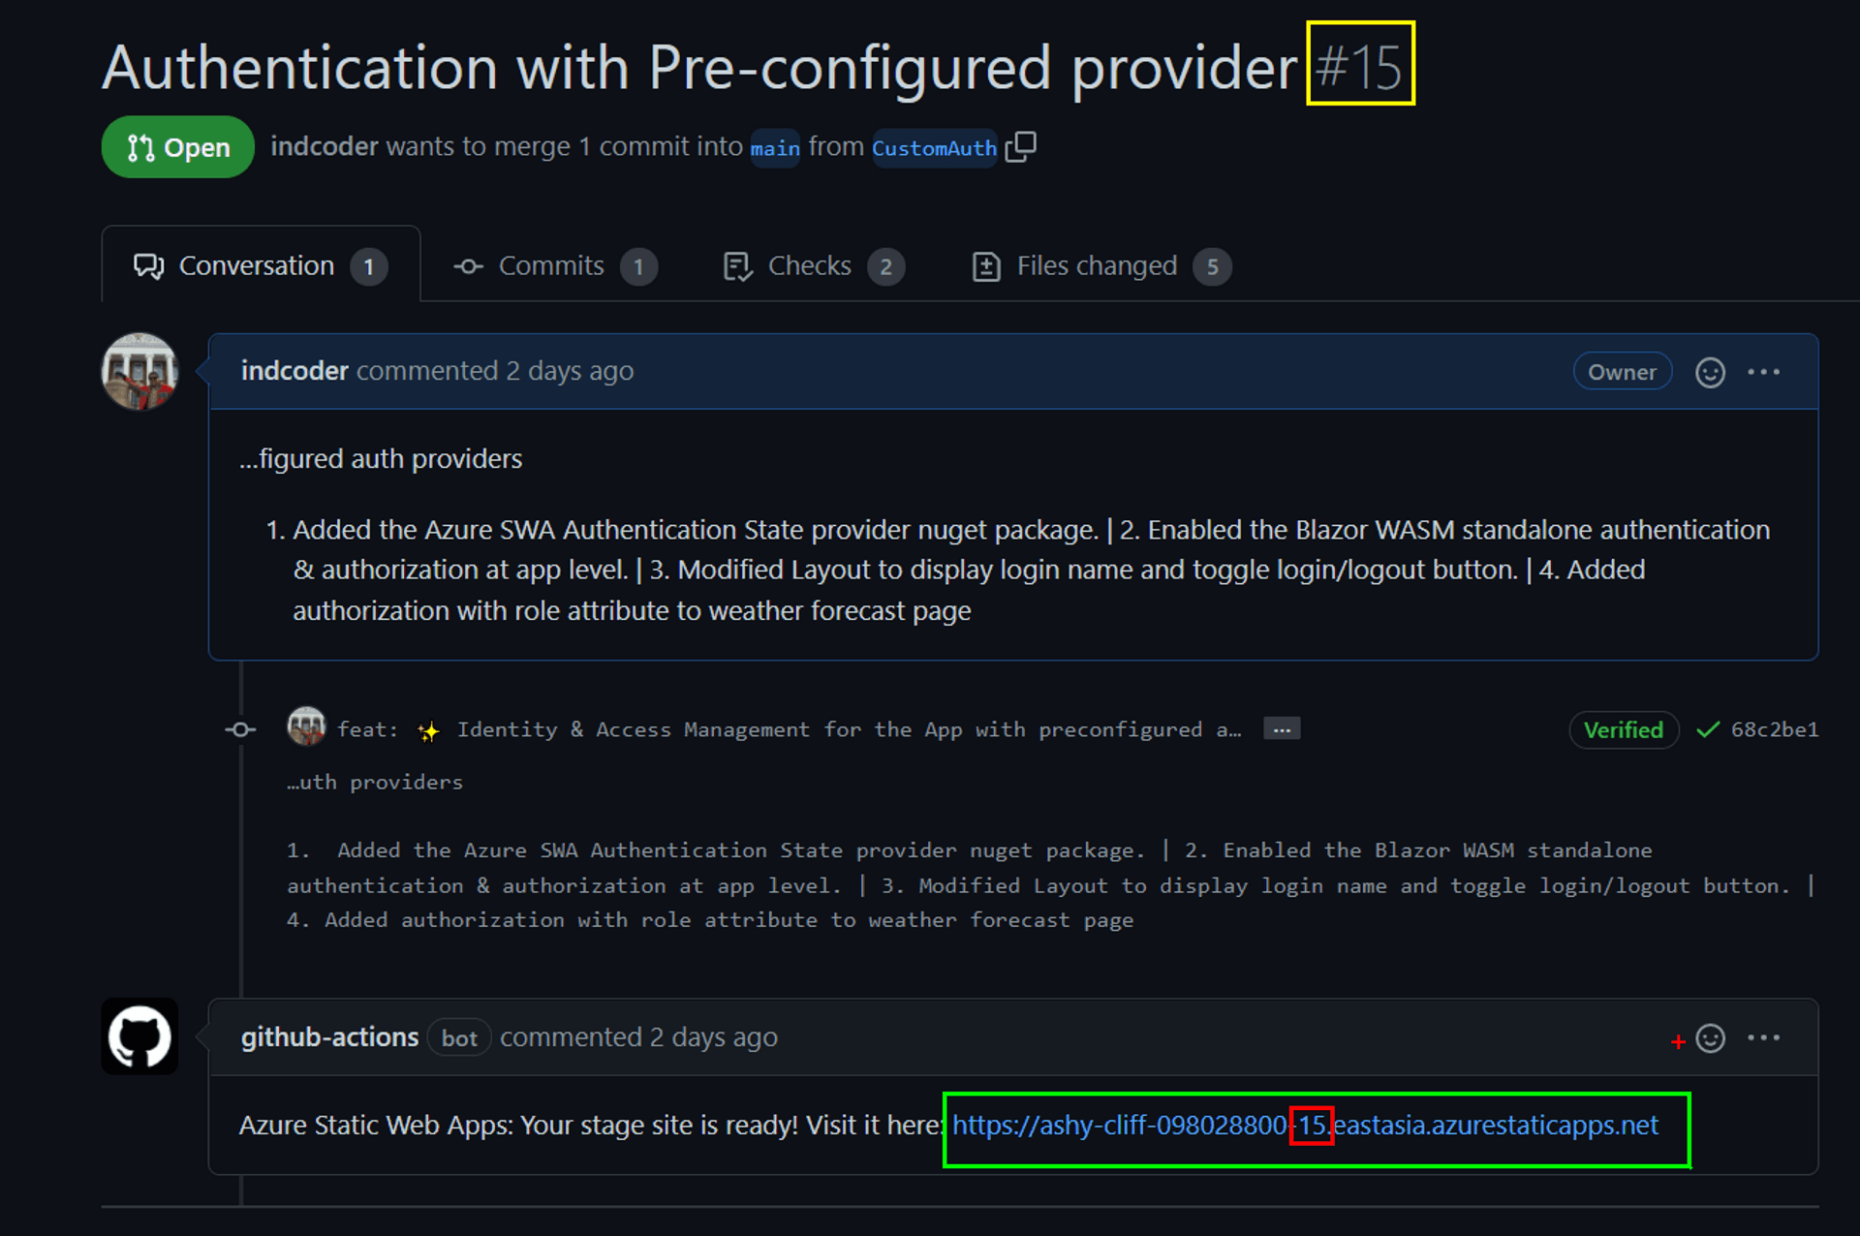
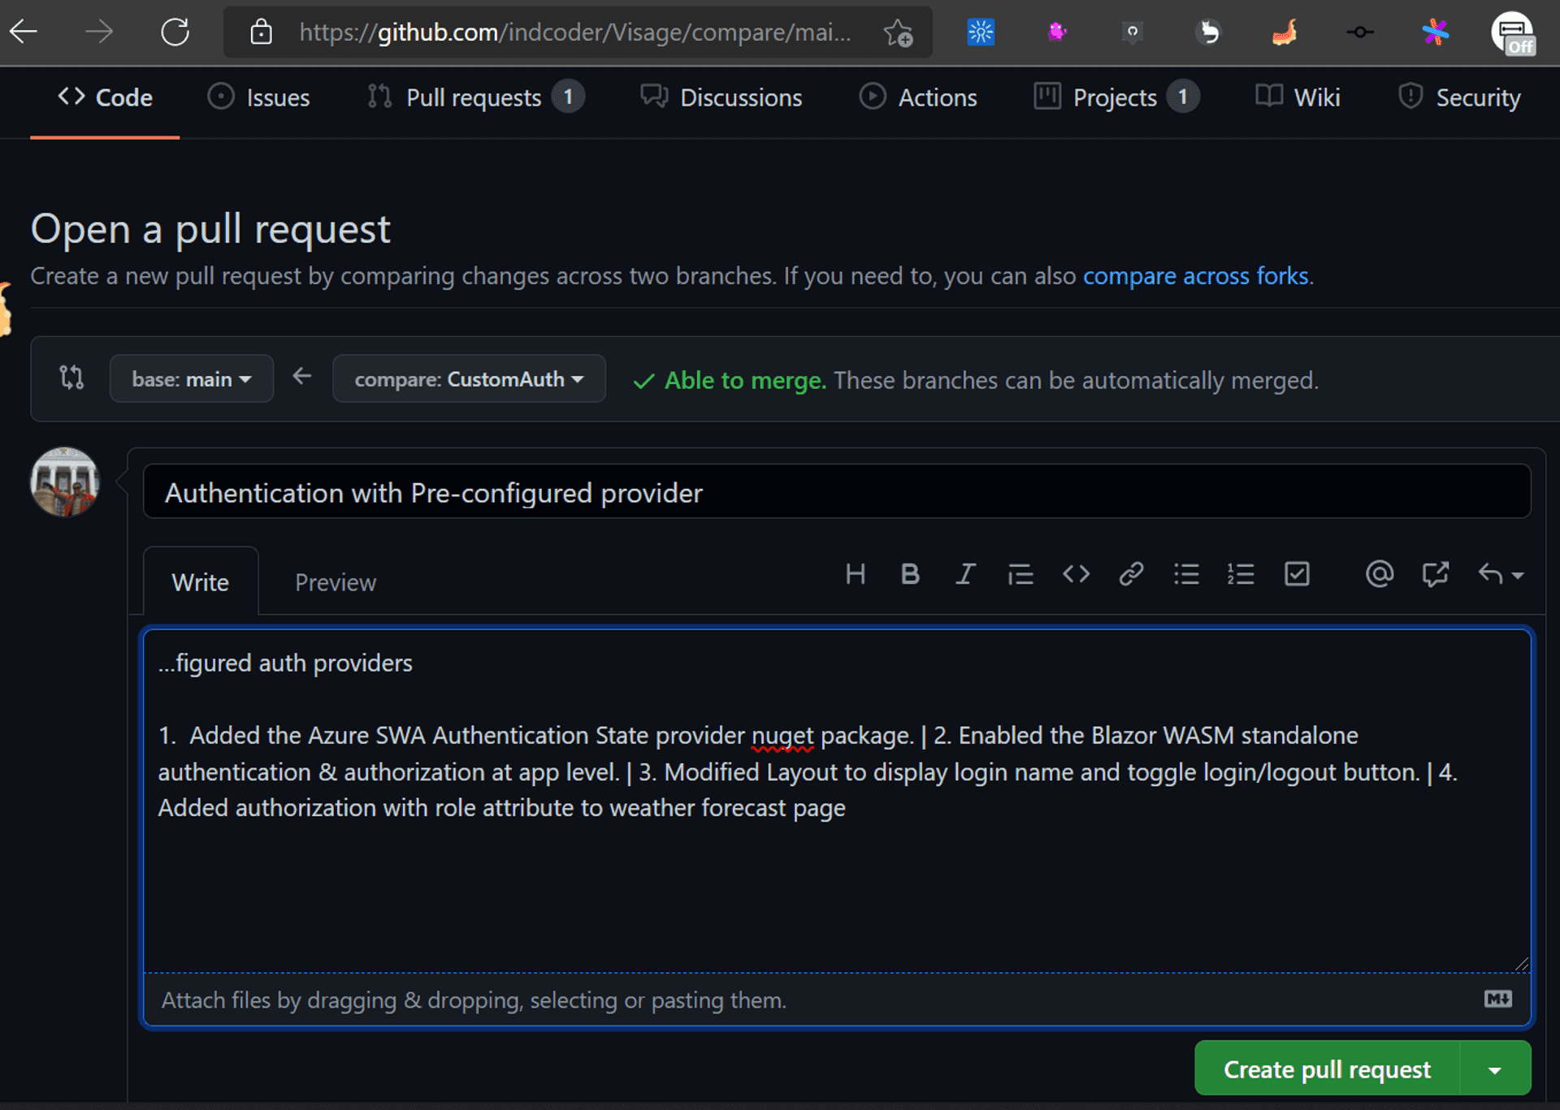
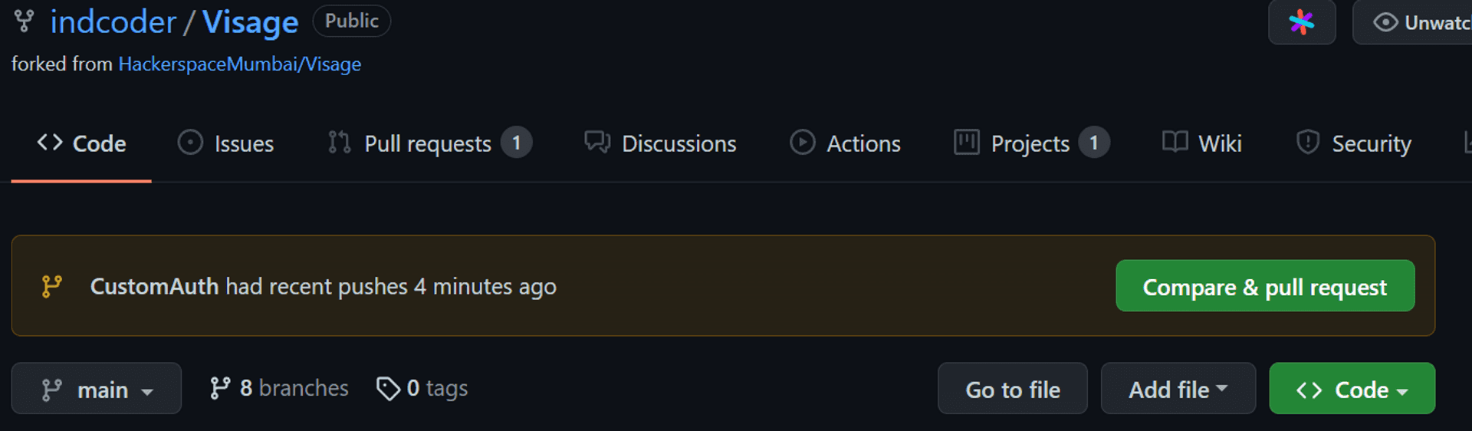
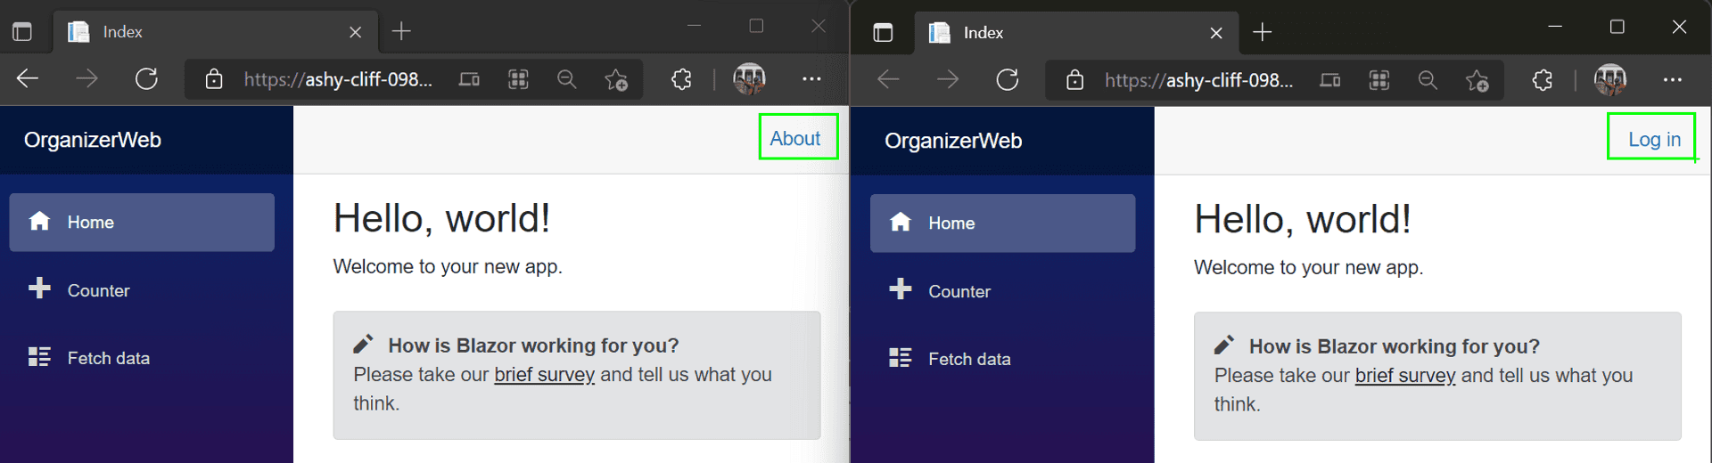
Pull request in pre-production

Slide 32
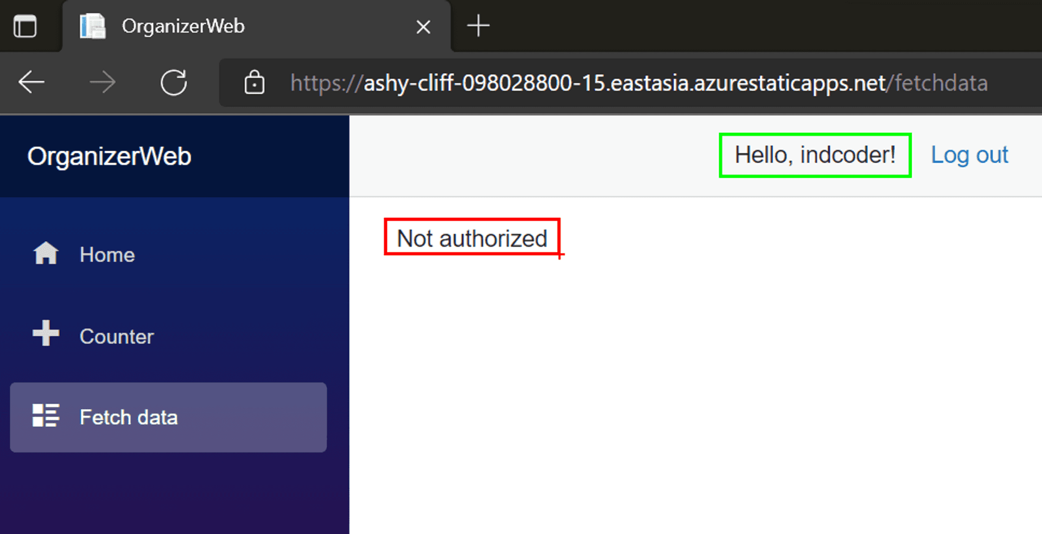
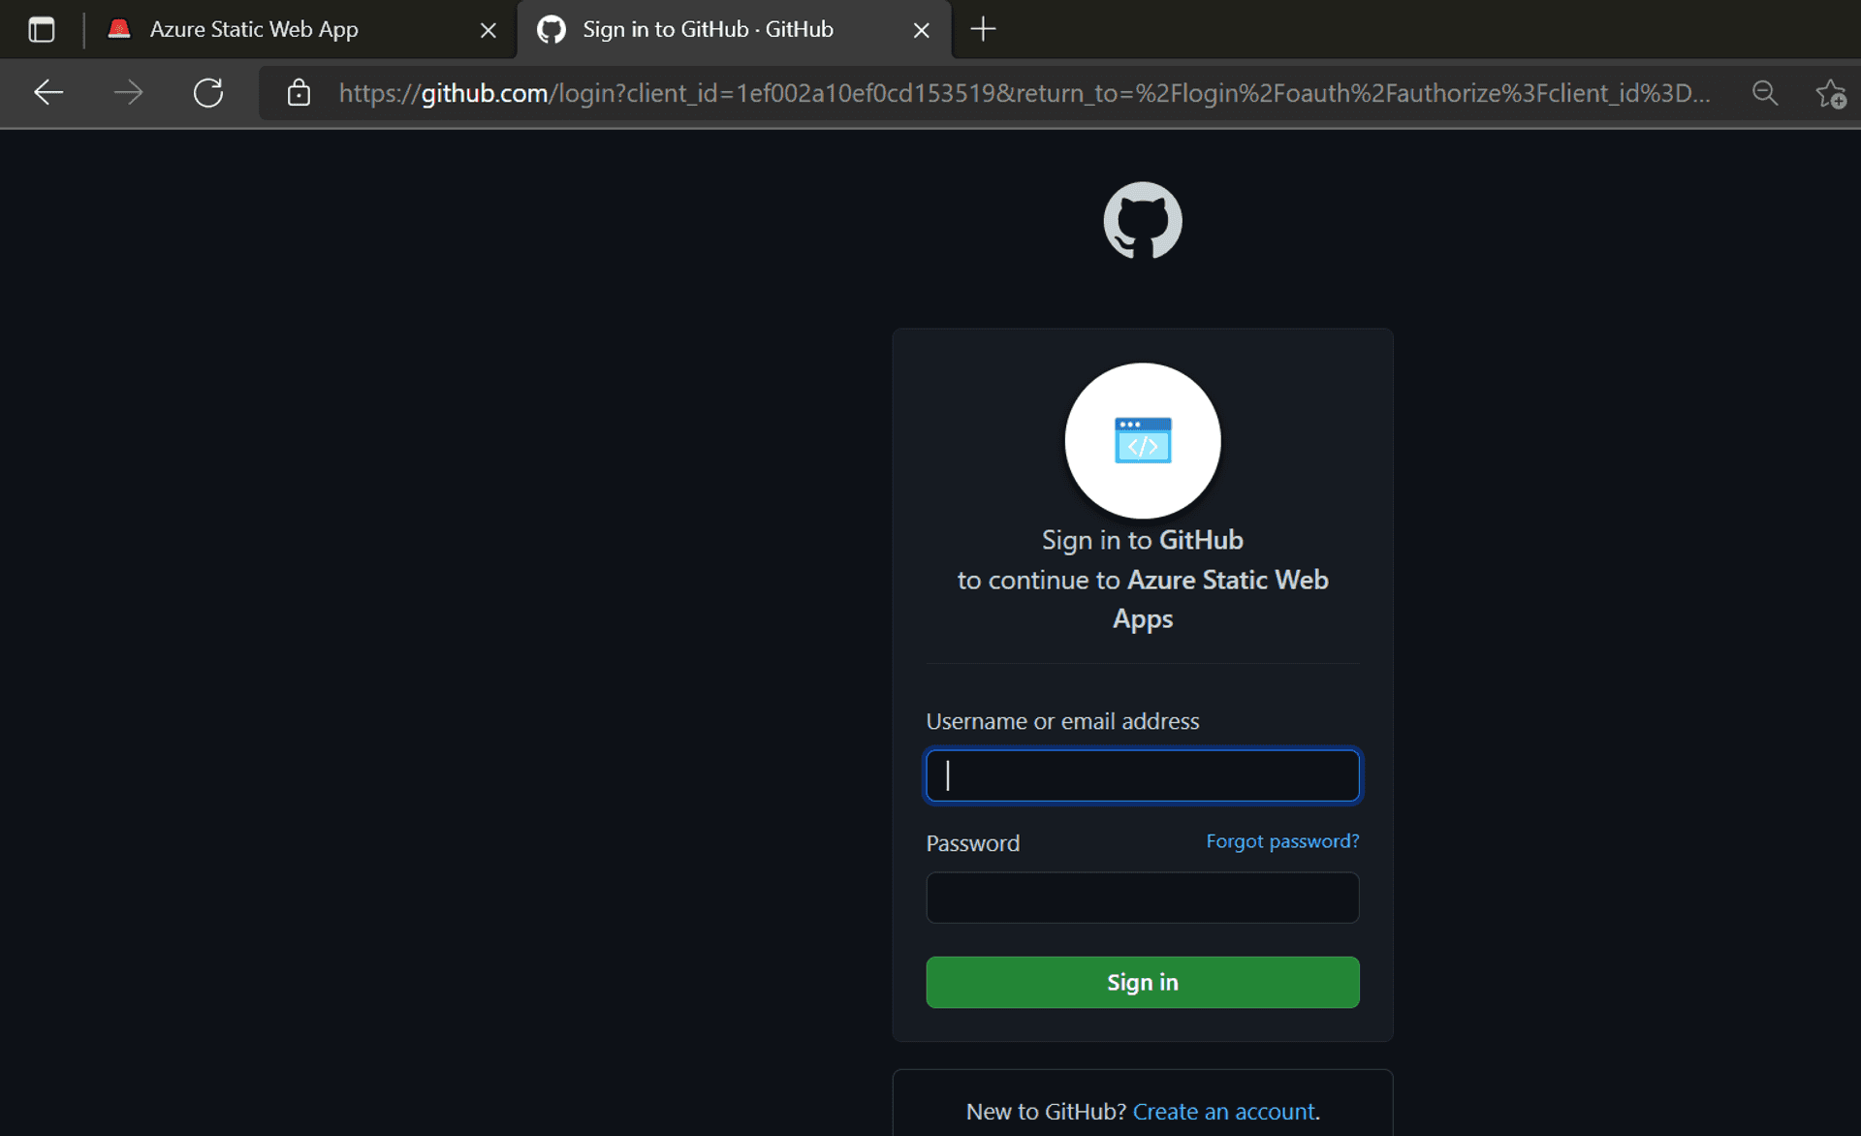
The real deal

Slide 33
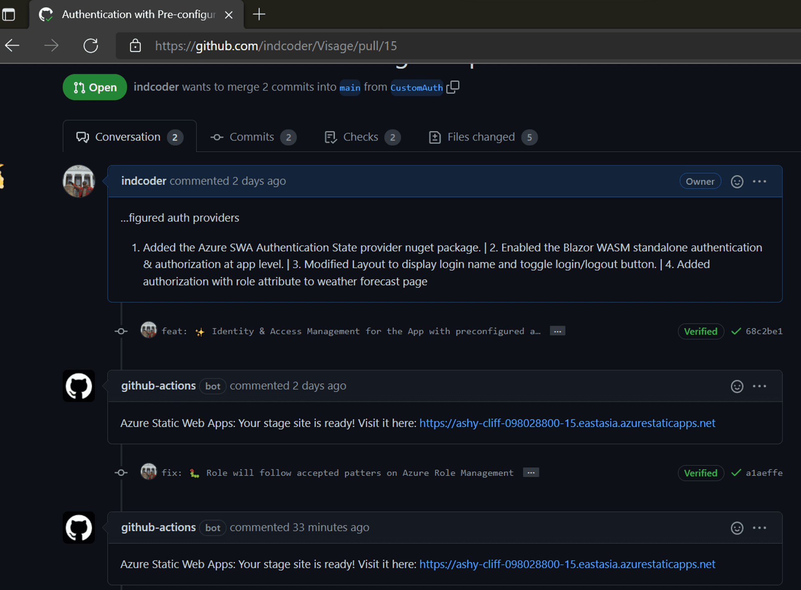
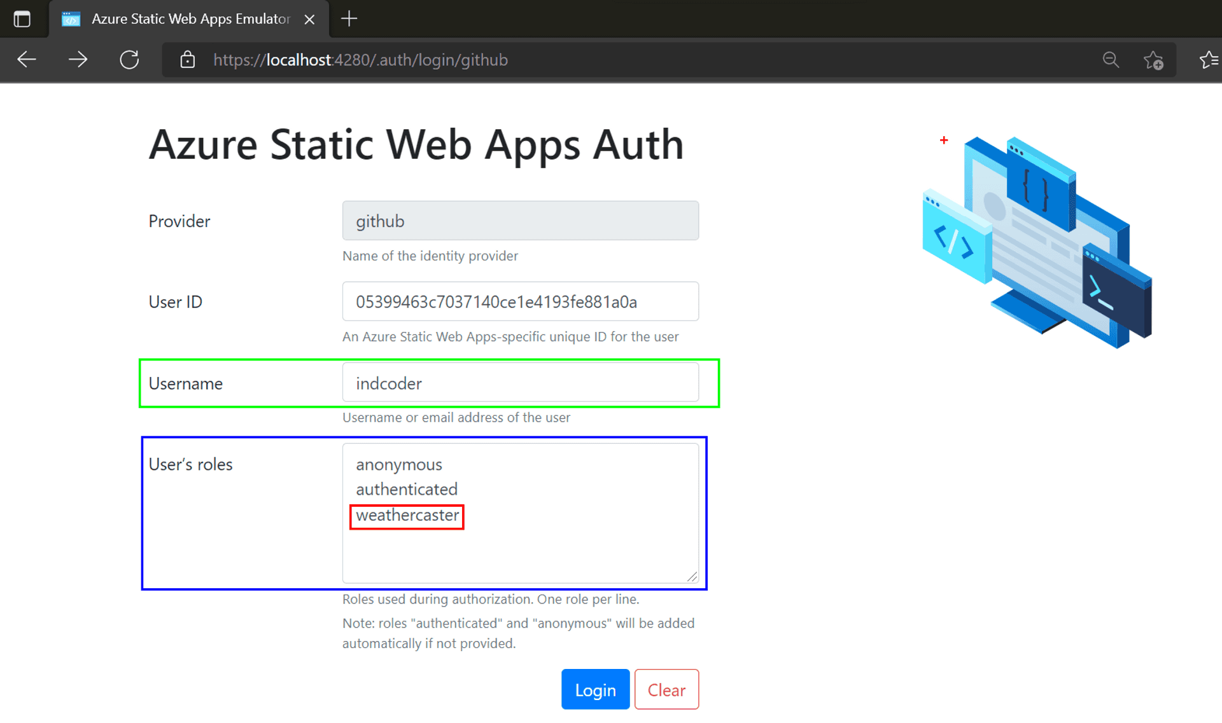
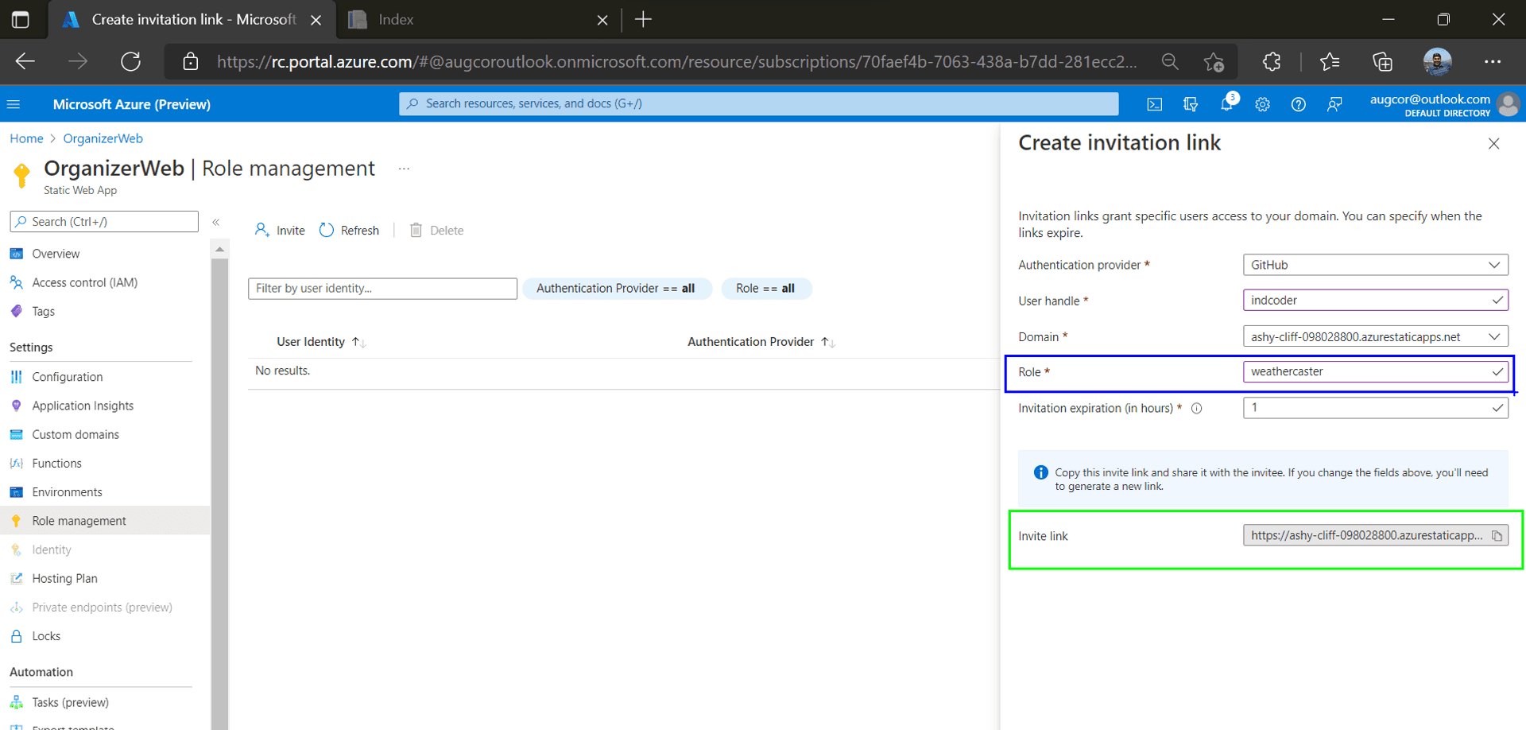
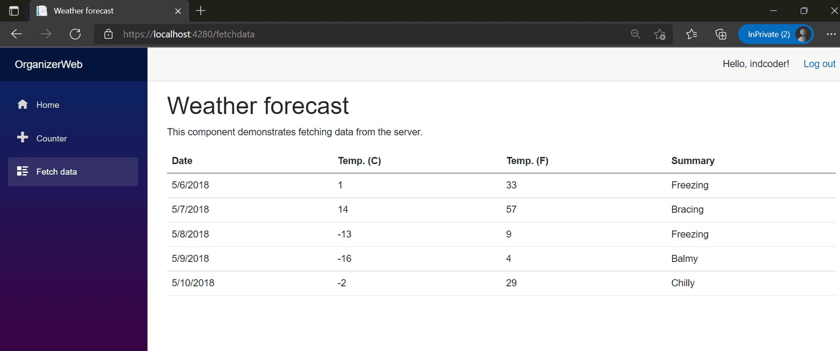
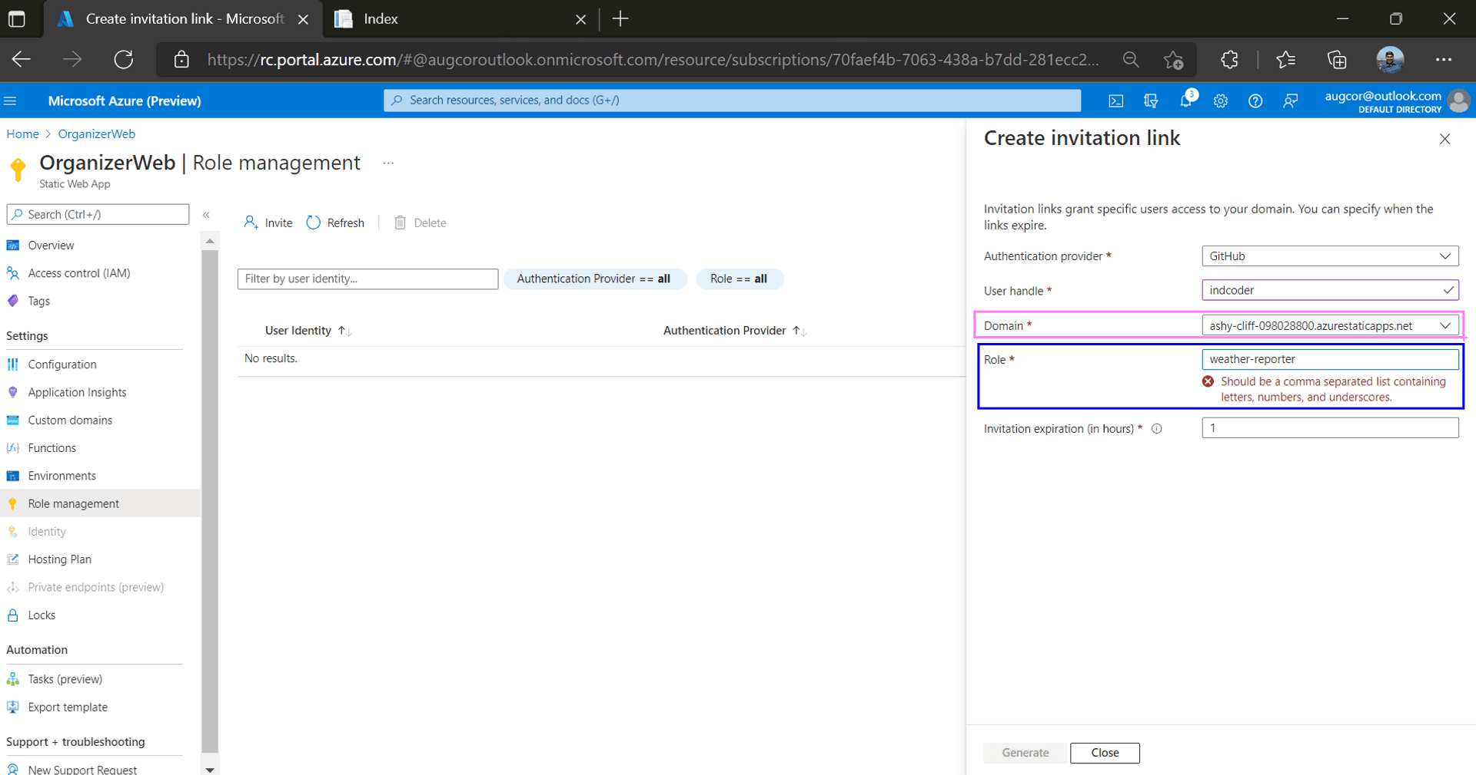
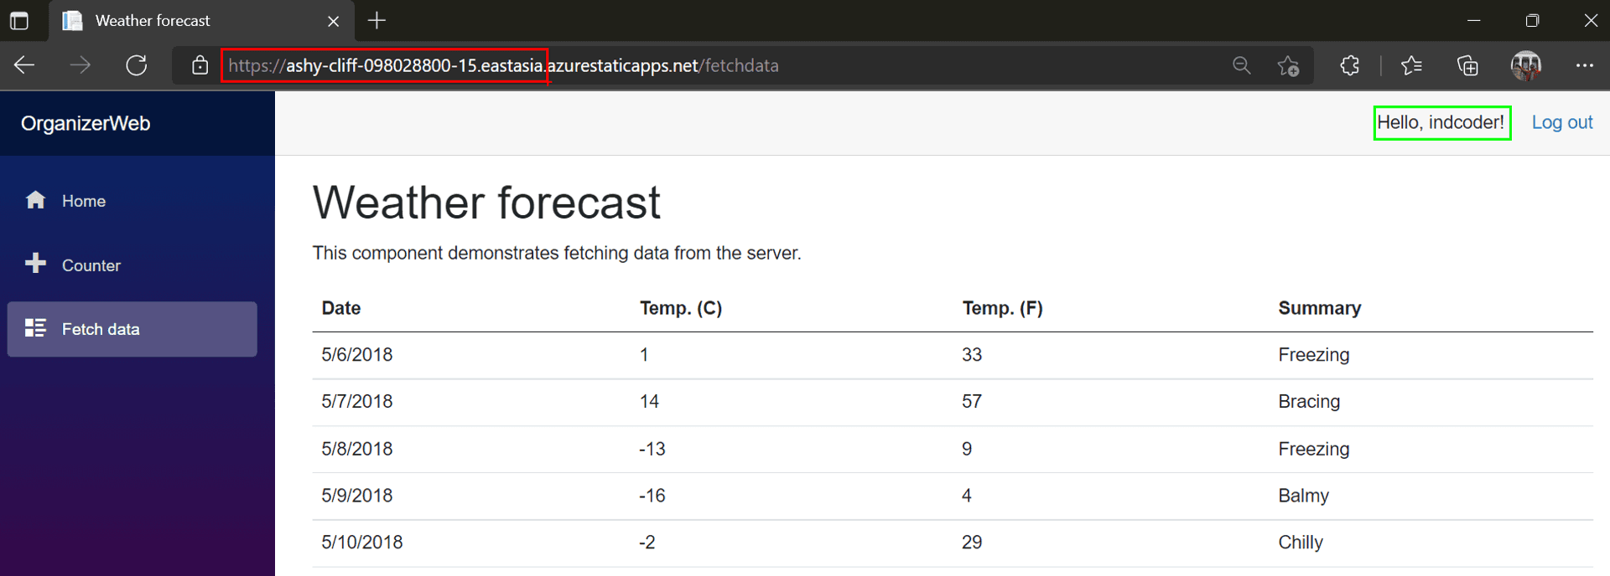
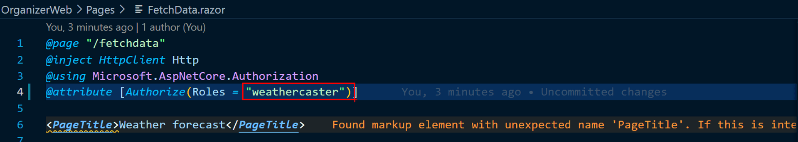
Are you invited?

Slide 34
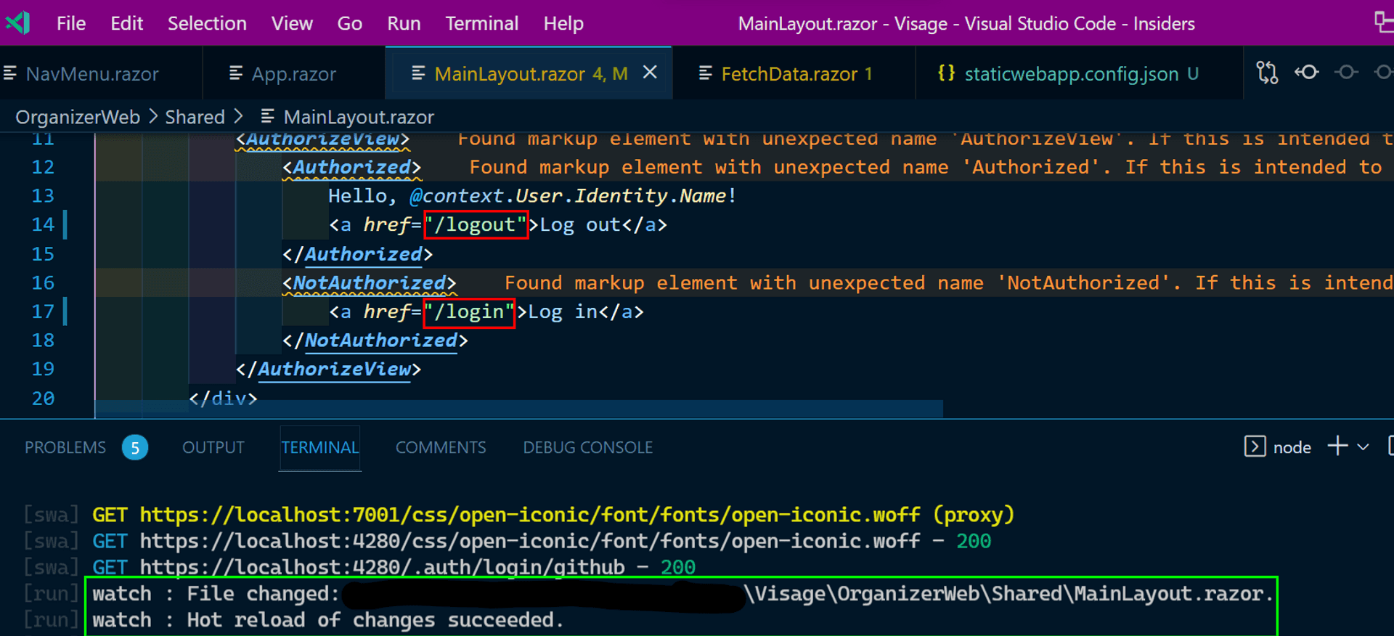
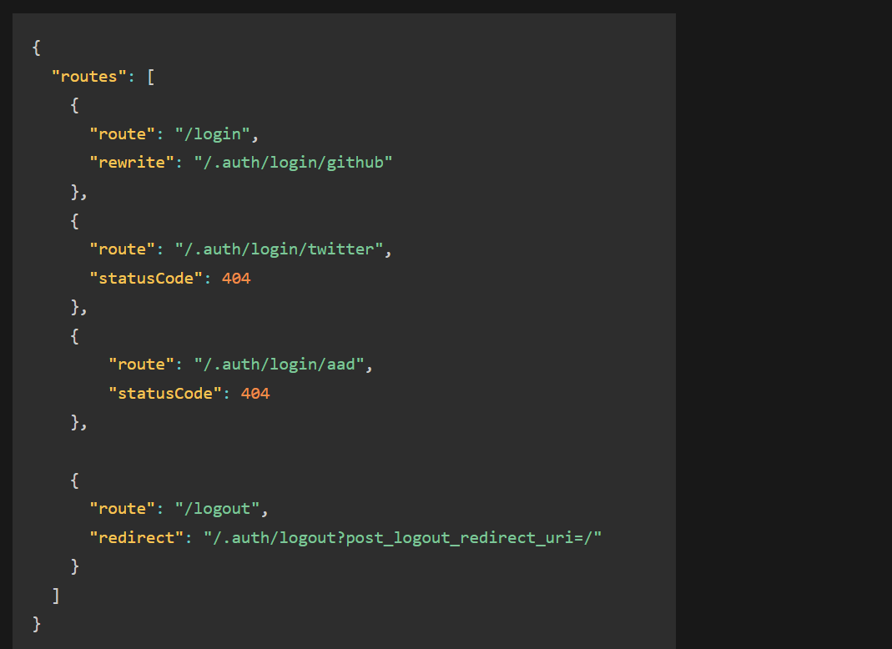
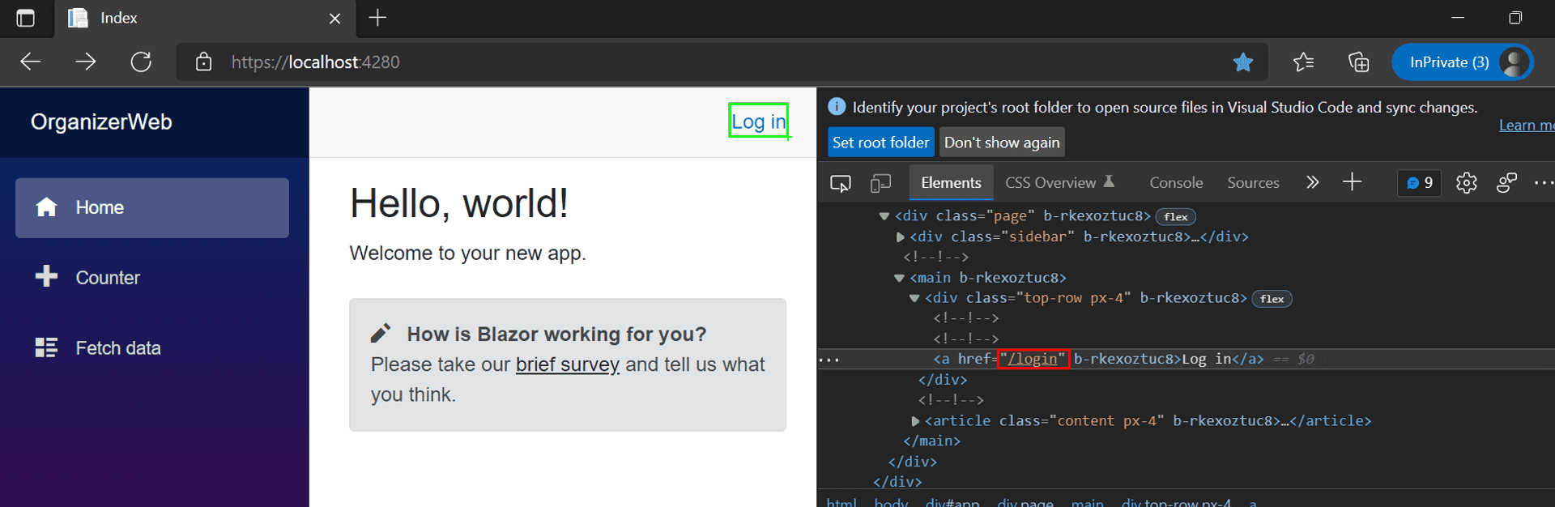
Custom Routing

Slide 35




Secure Routes by Role

Slide 36

Fallback Routes

Slide 37
Recap
1. Created a Blazor WASM on local workstation
2. Installed and used the Azure SWA CLI emulator to test the app locally.
3. Configured the app for authentication and authorization.
4. Validated via the SWA CLI the above IAM configuration on our local workstation
5. Pushed our feature branch to GitHub, which was automatically deployed on Azure SWA via GitHub Actions.
6. A dedicated stage URL was created for us to test the feature of the app. A dedicated stage URL was created for us to test the feature of the app.
7. Refactored our code, and configured the Azure SWA on the Azure Portal to use the roles given to our GitHub profile.

Slide 38

Change the Plan

Slide 39

Configuration – Azure Portal

Slide 40


Configuring Code

Slide 41


Rinse & repeat

Slide 42

Authorization by 3rd party

Slide 43

Trust but verify

Slide 44



Role Management

Slide 45






Platinum Partner
Gold Partner
Silver Partner

Slide 46
Q&A

Slide 47

Securing a Blazor WASM app on Azure Static Web App
Augustine Correa
Microsoft MVP
Twitter: @augvcor
bit.ly/azconf22

